Slide 1
Main Figures

Slide 2
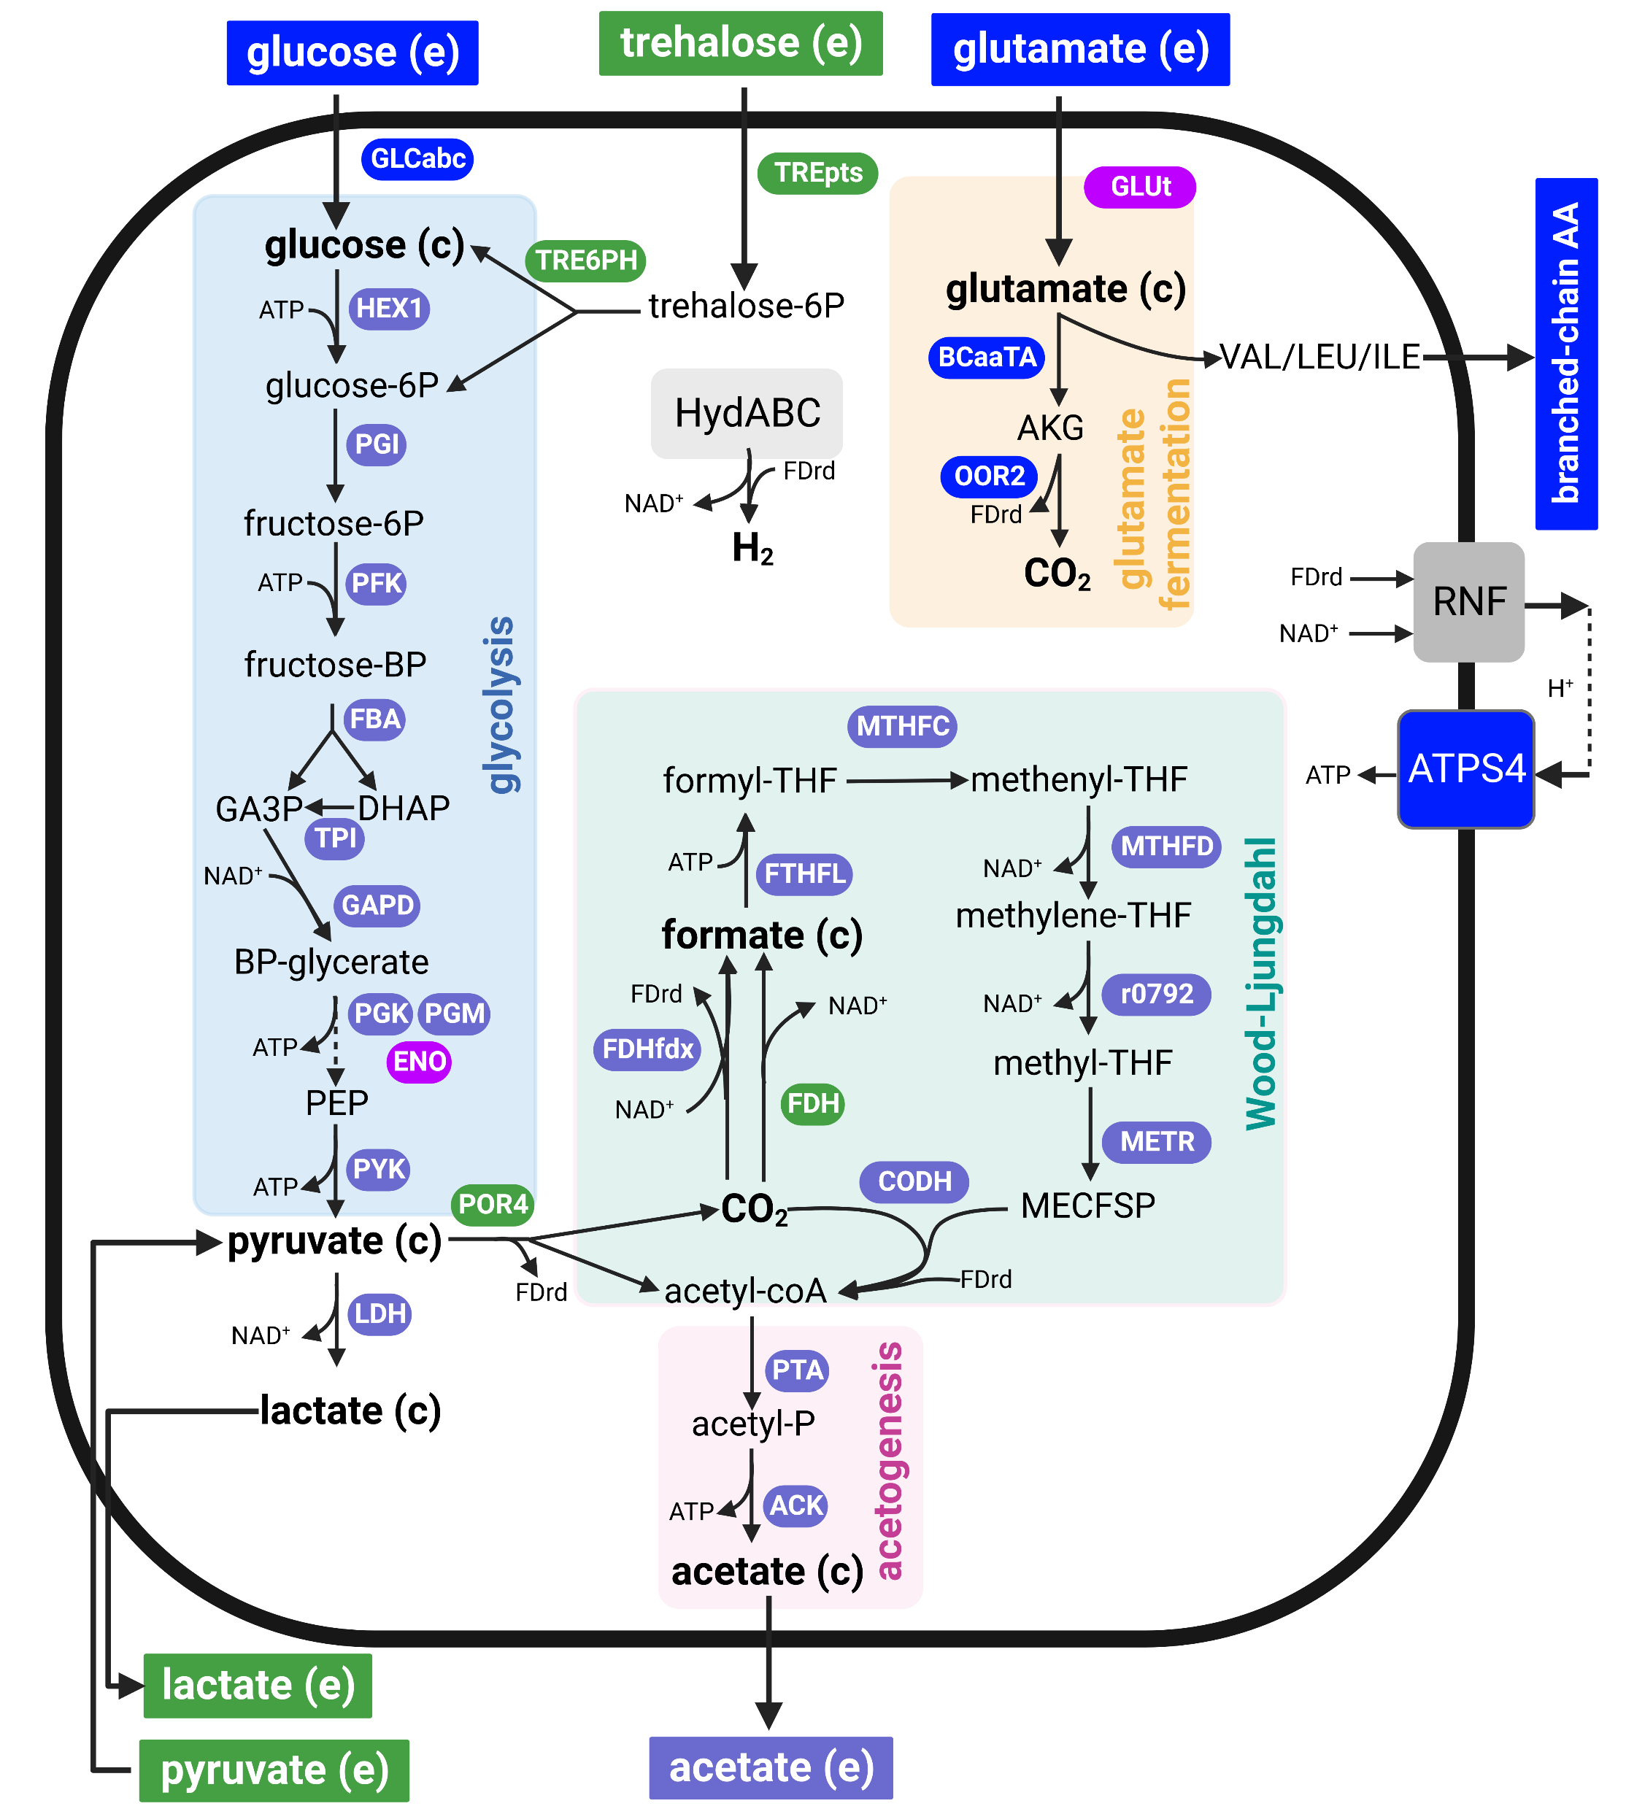
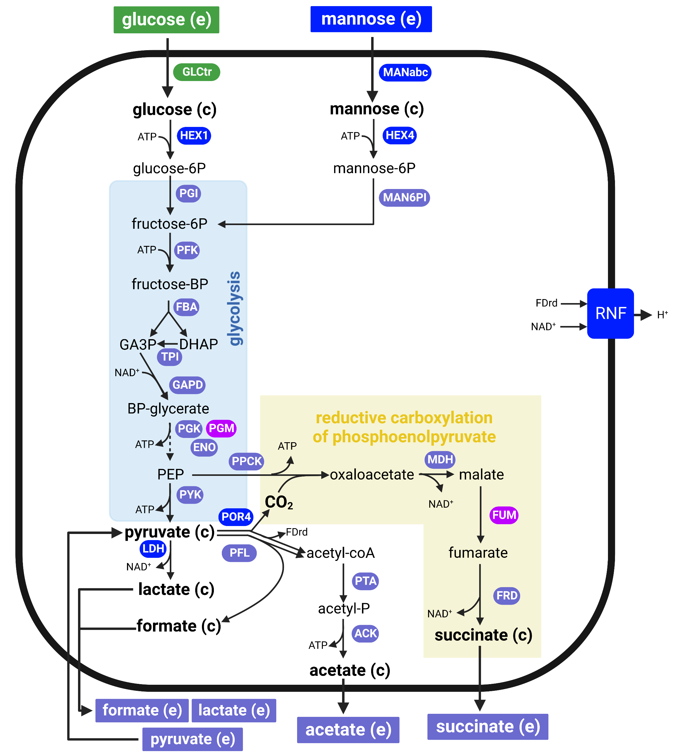
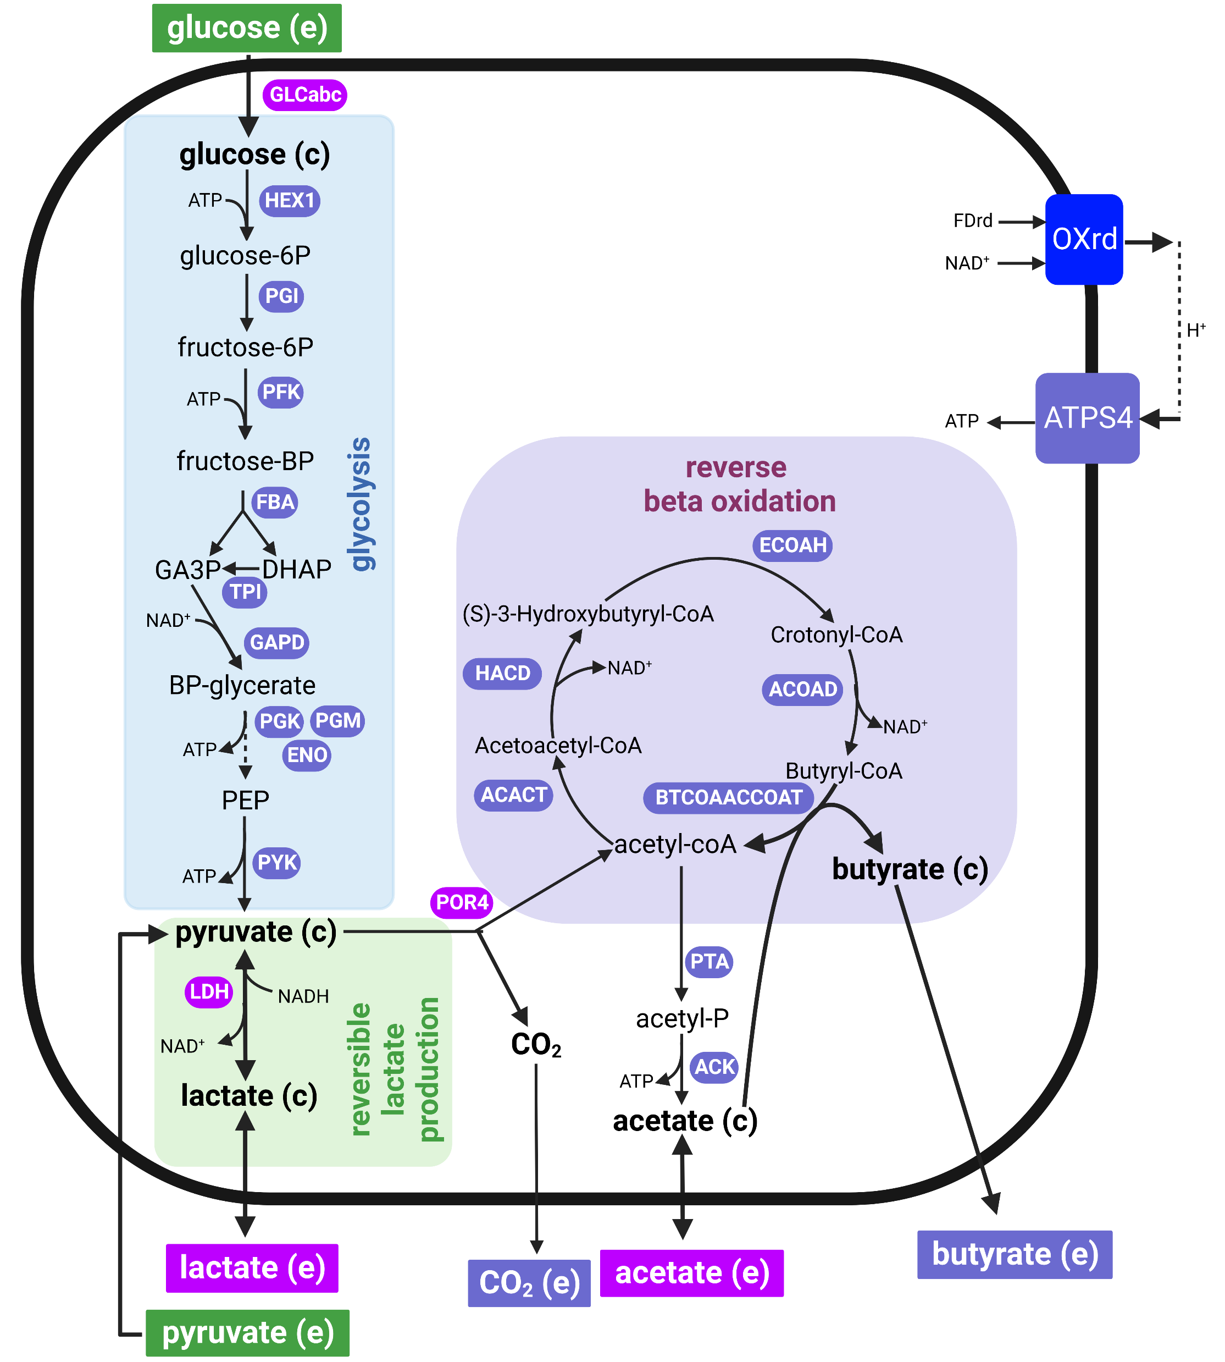
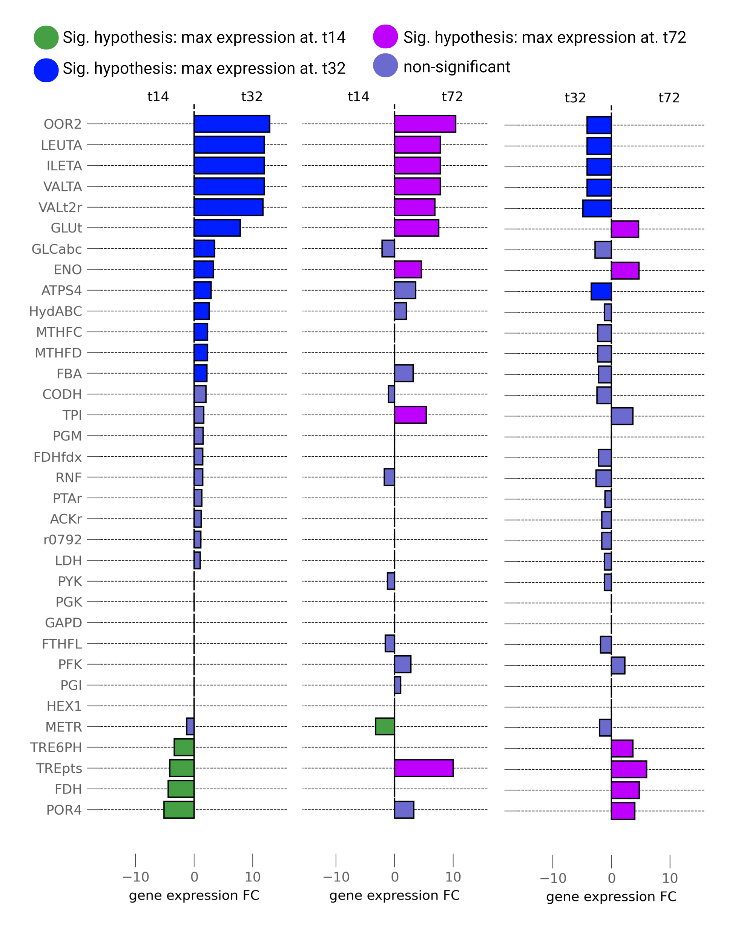
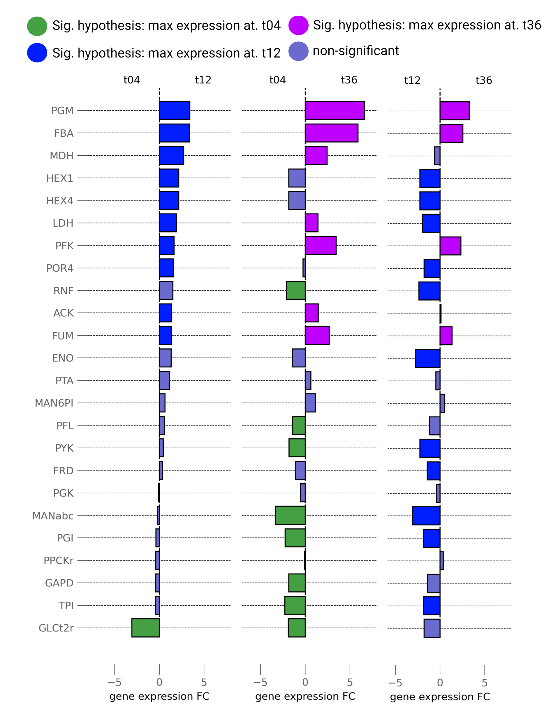
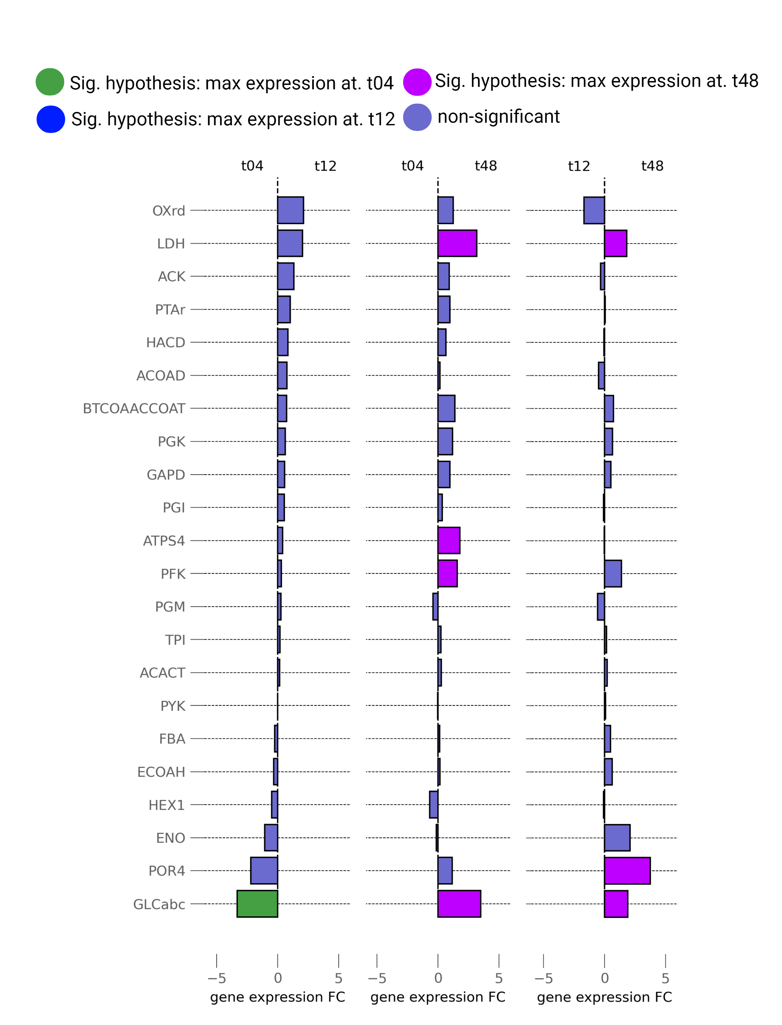
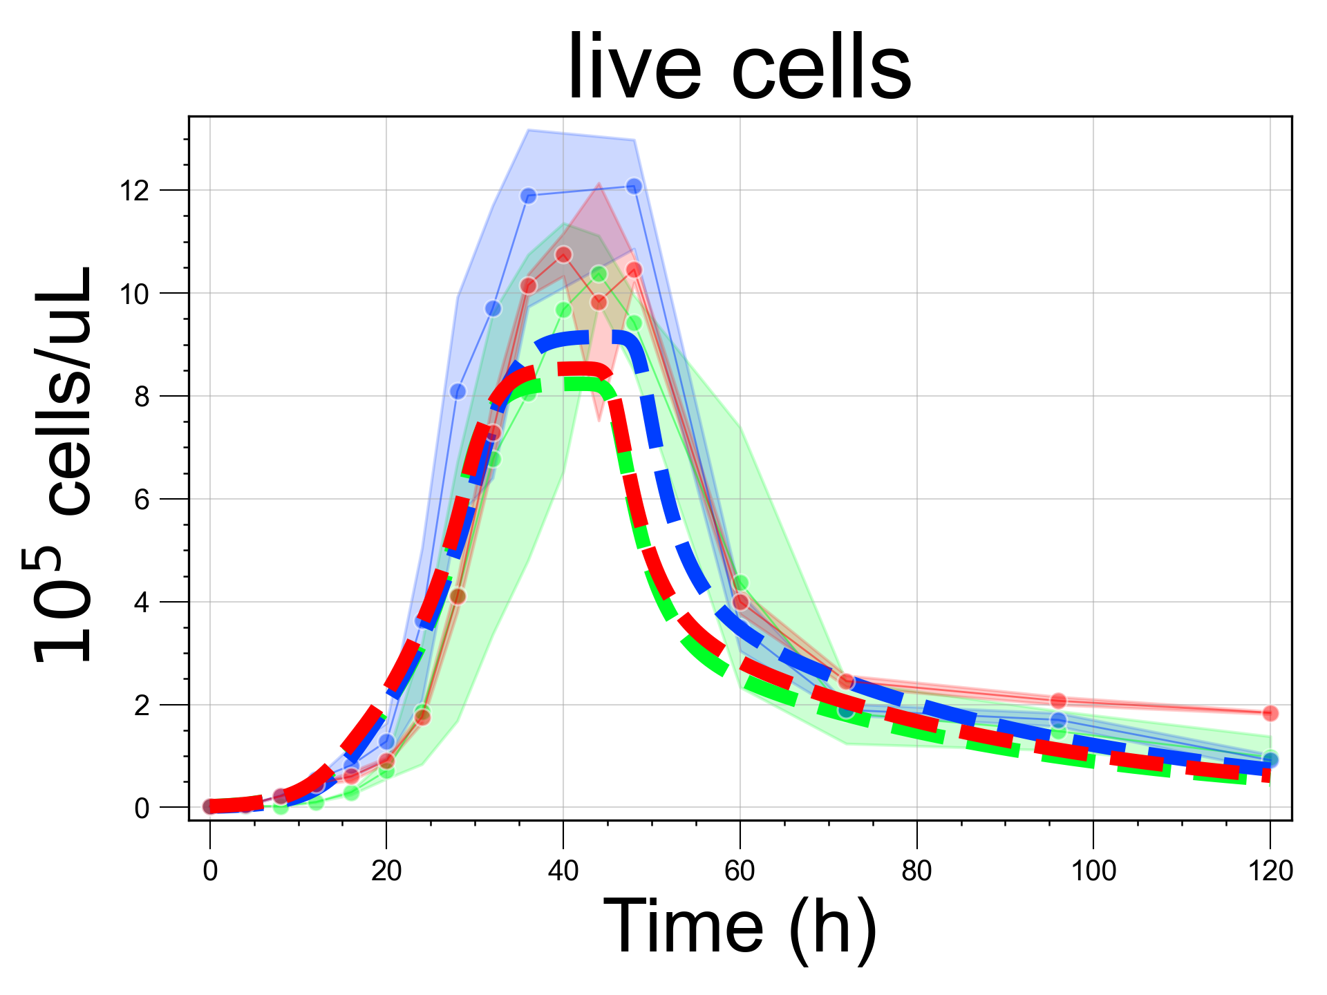
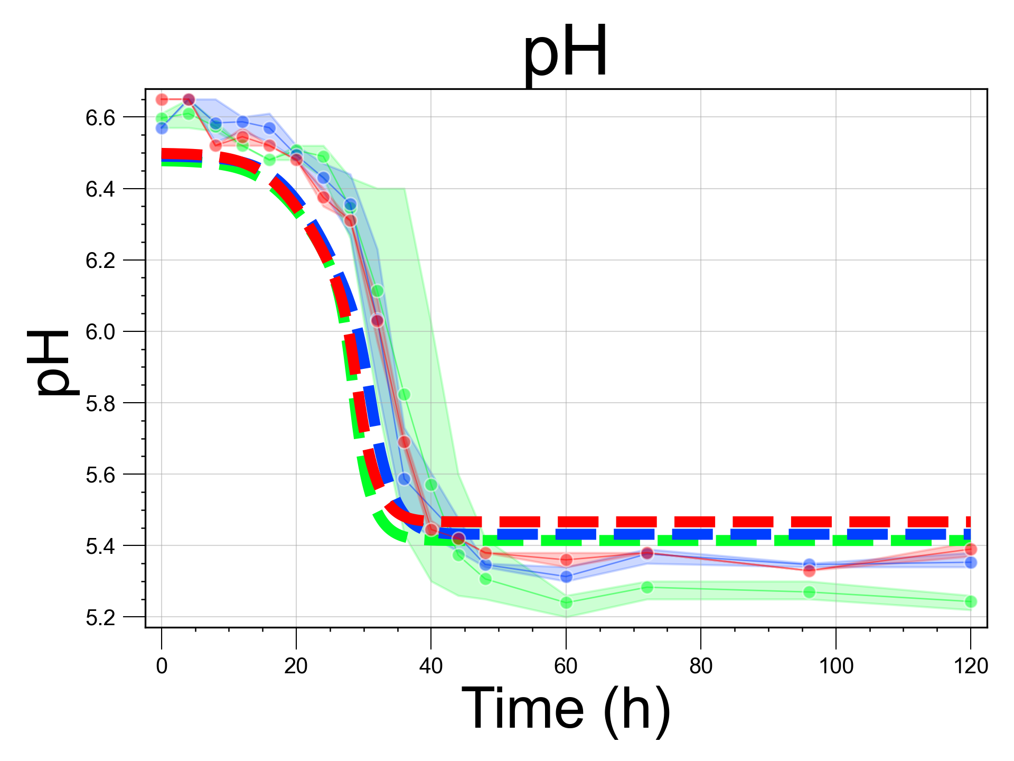
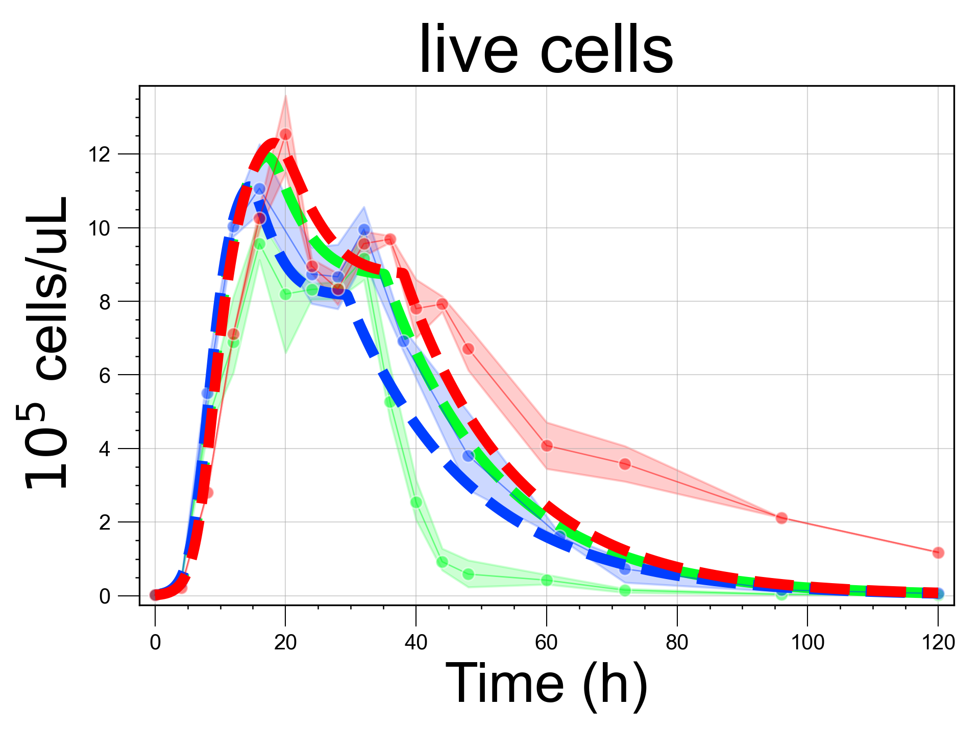
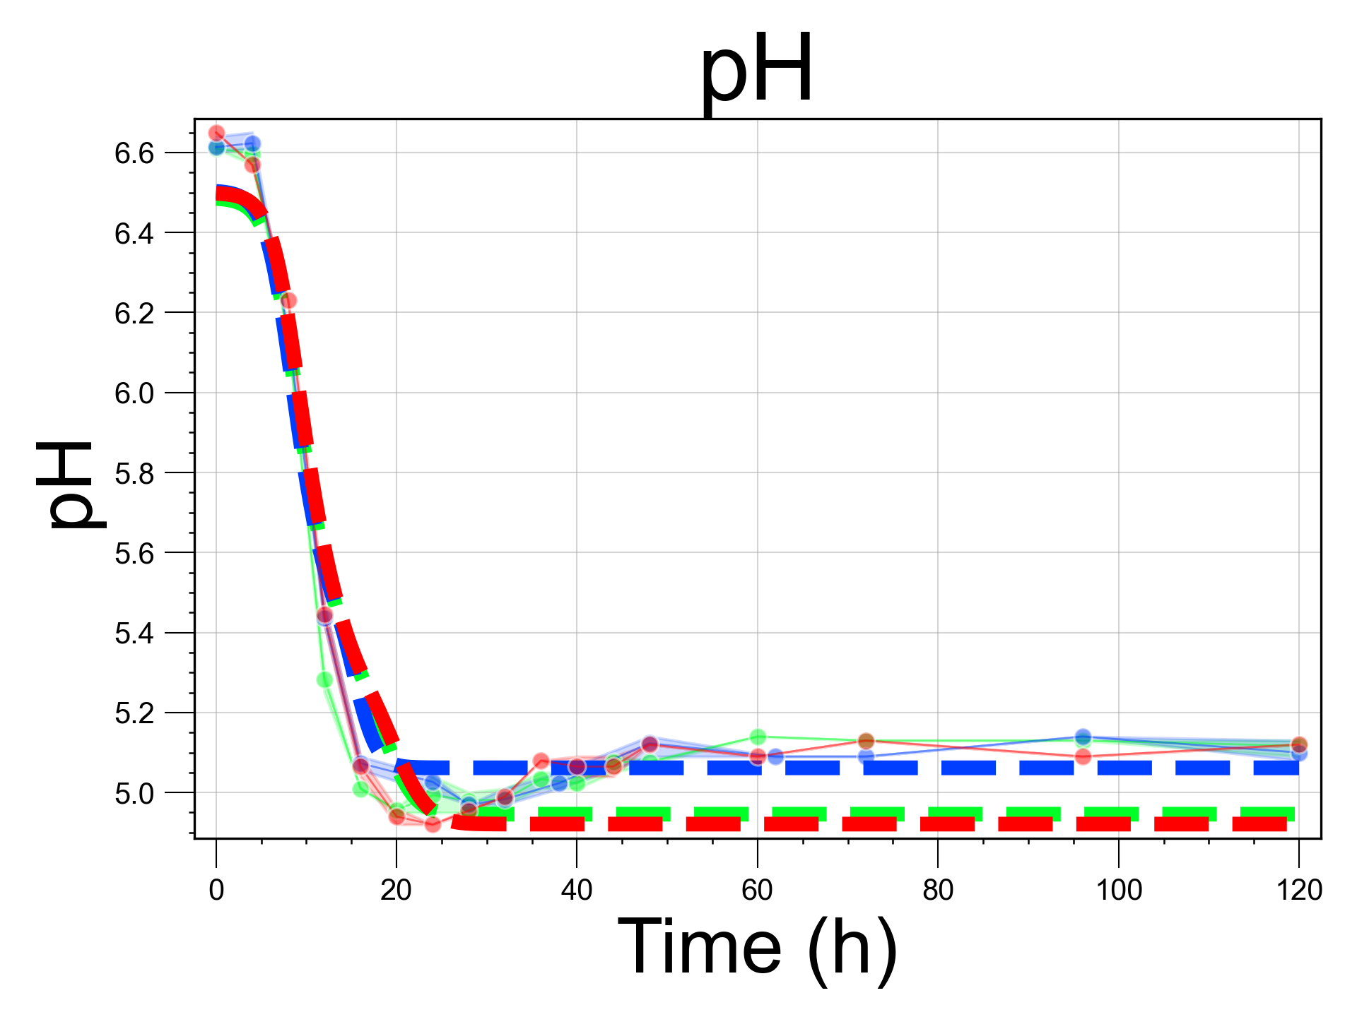
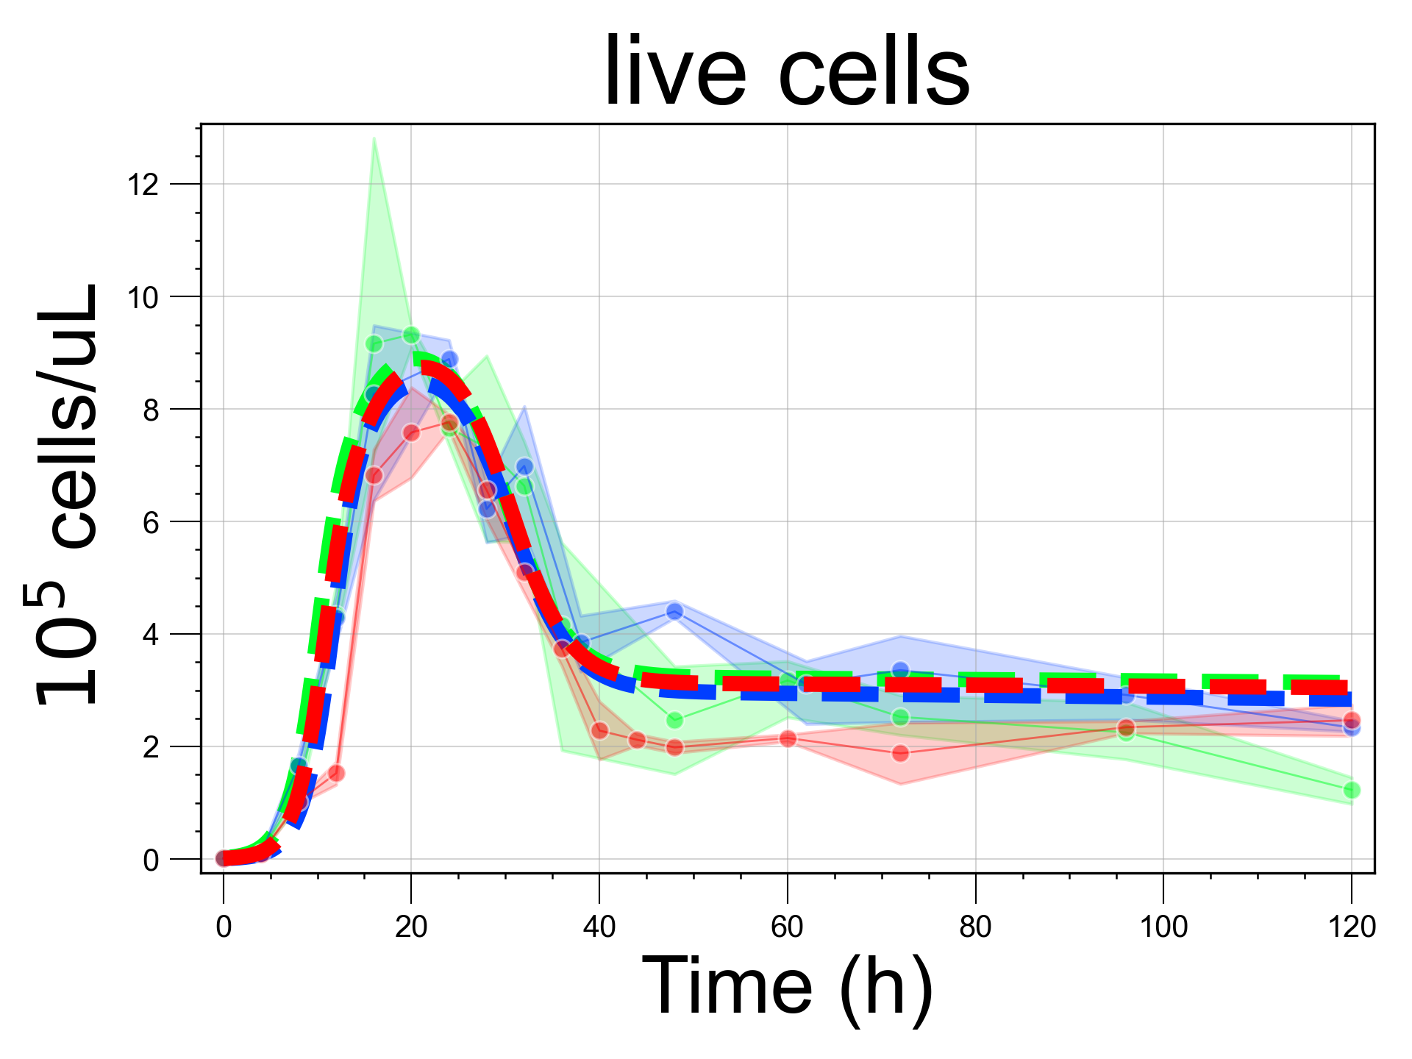
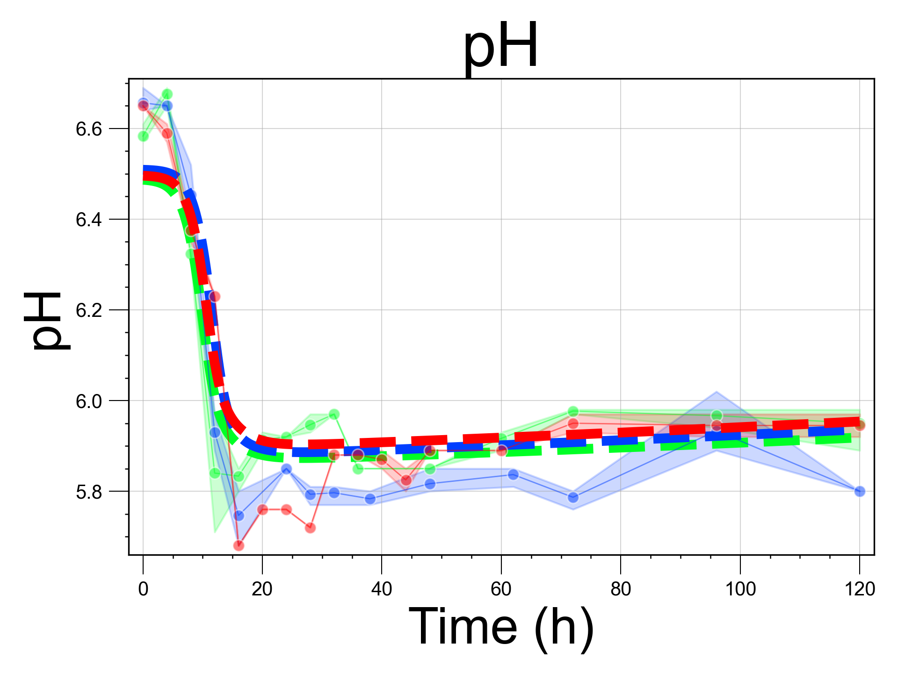
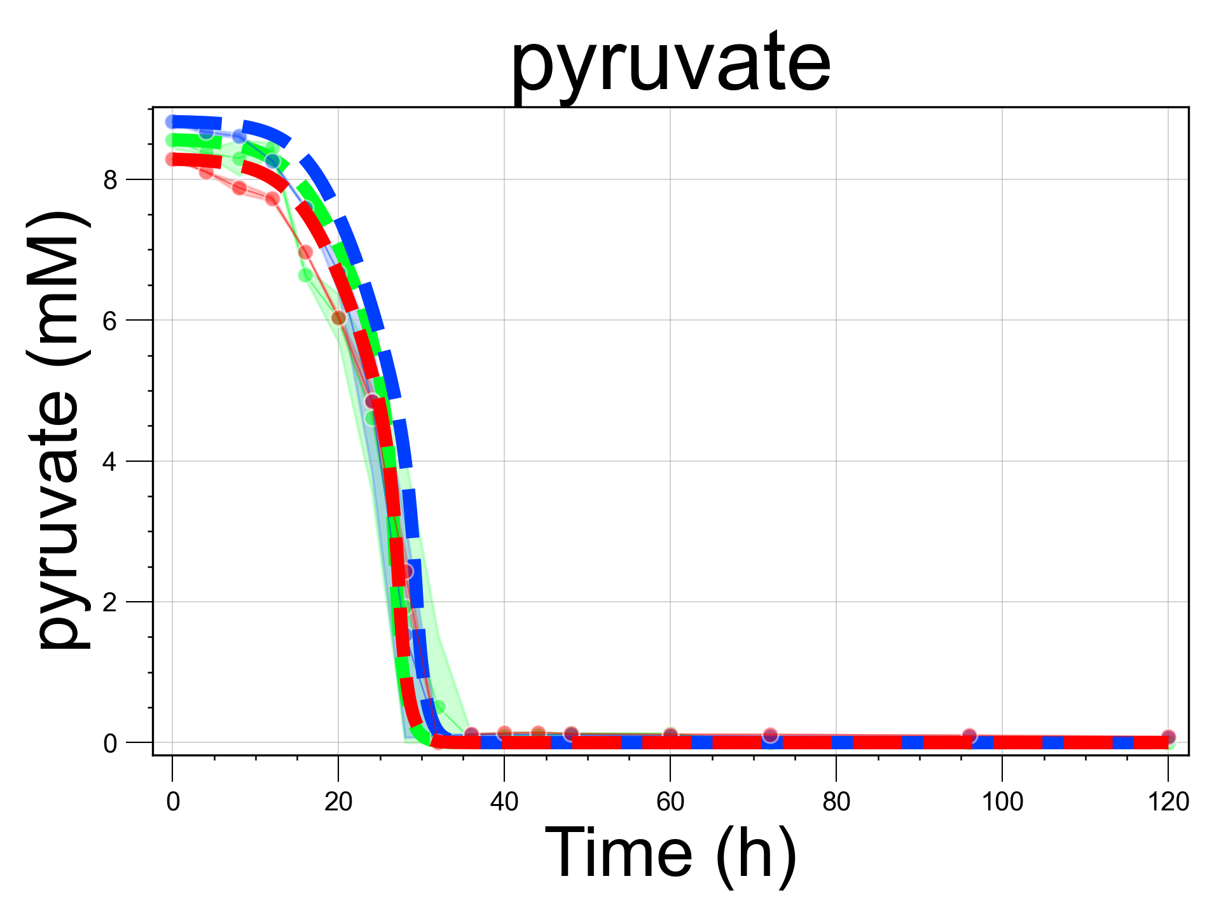
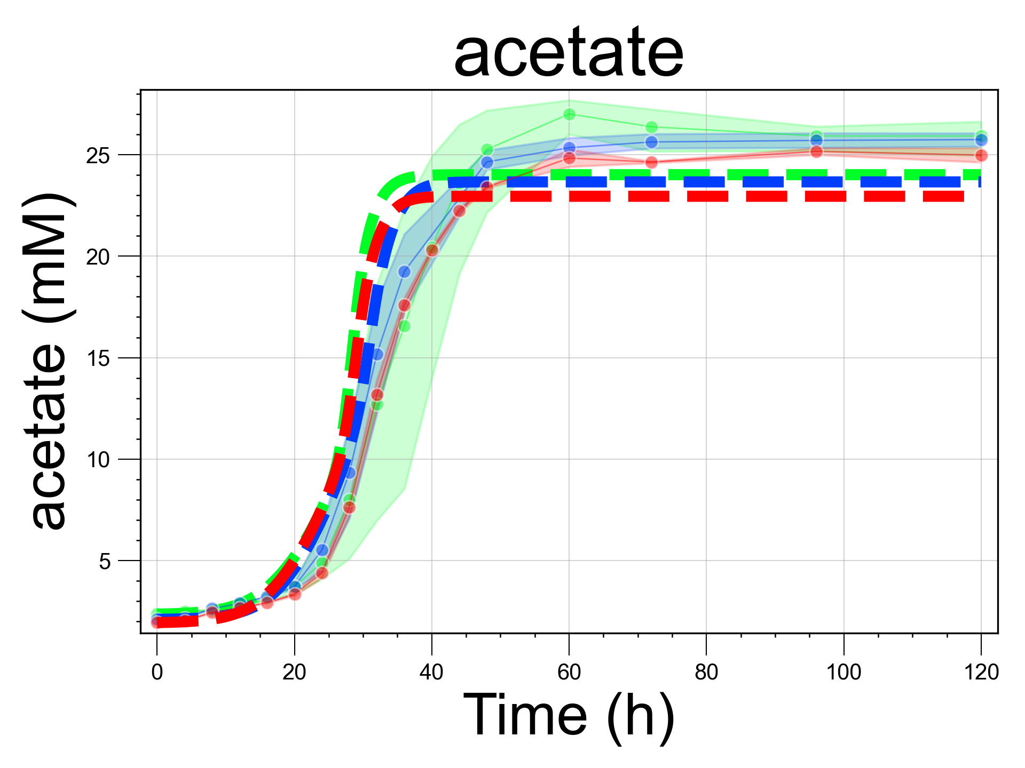
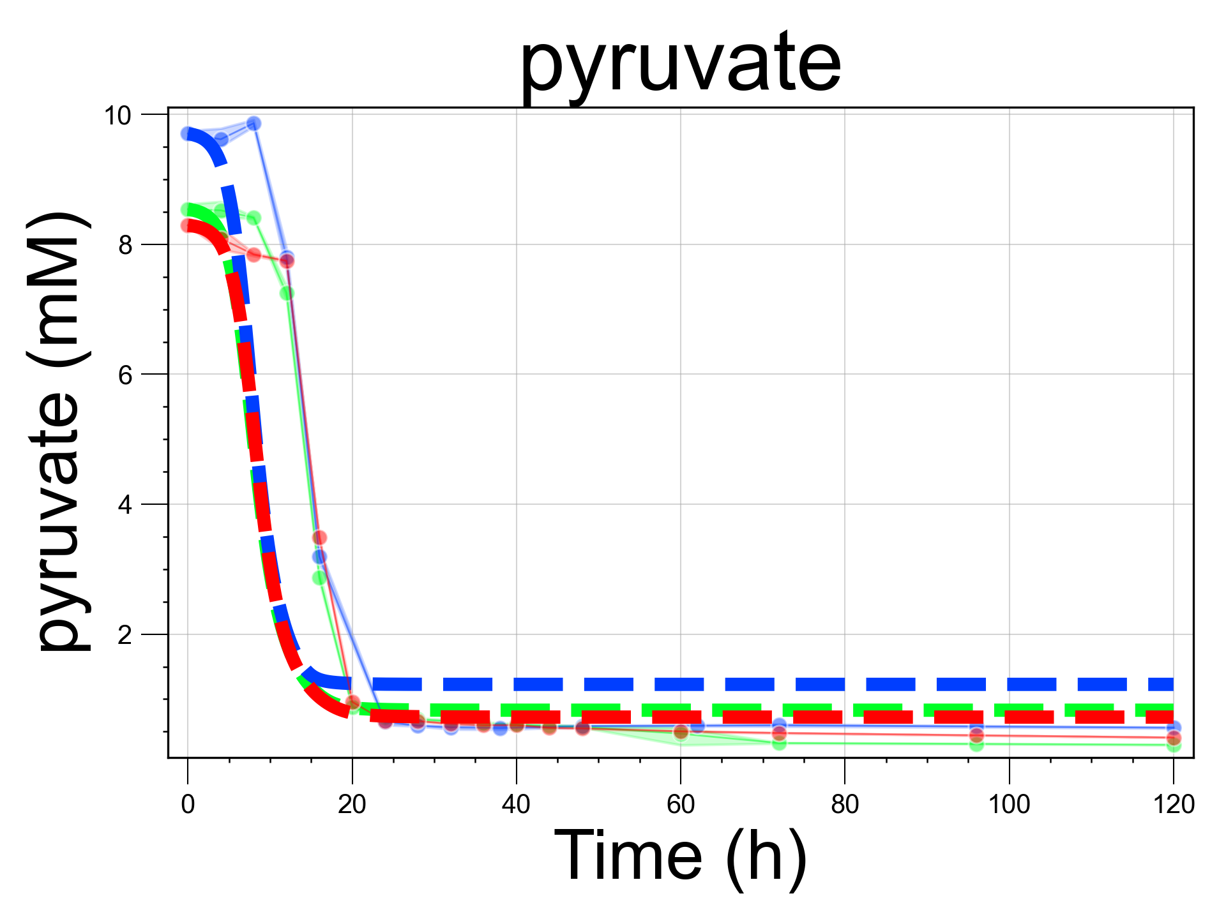
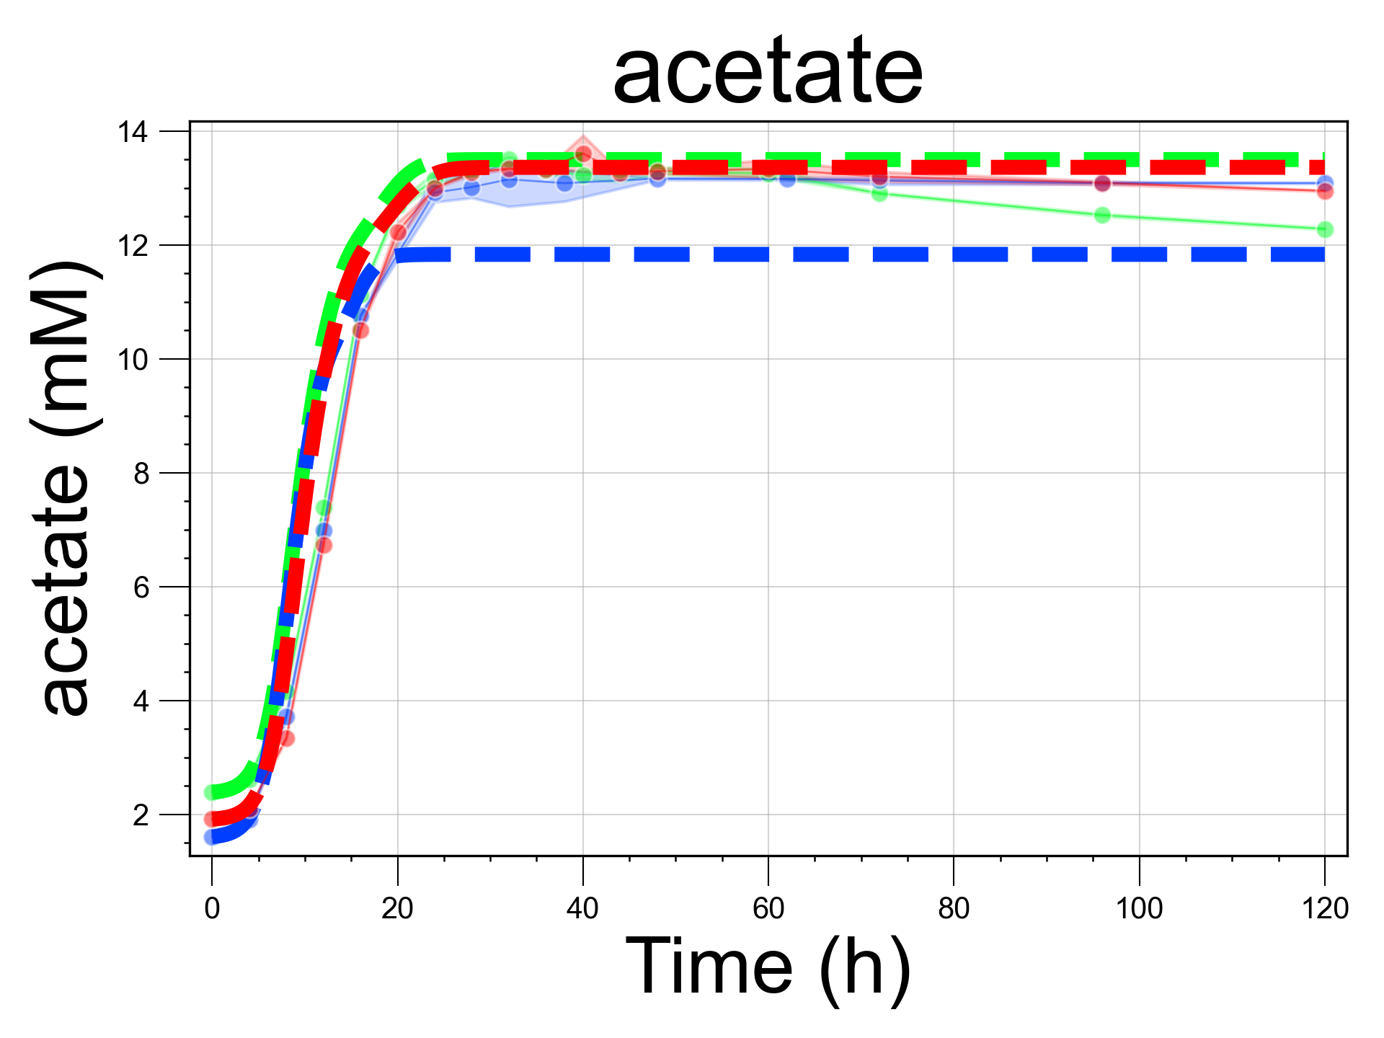
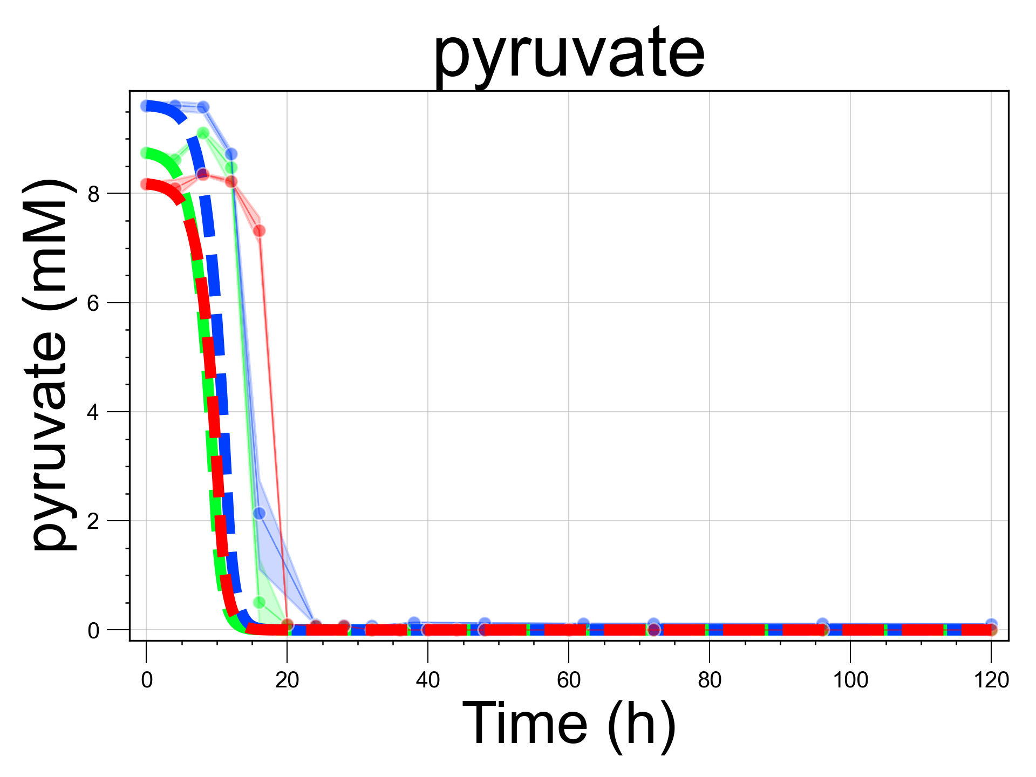
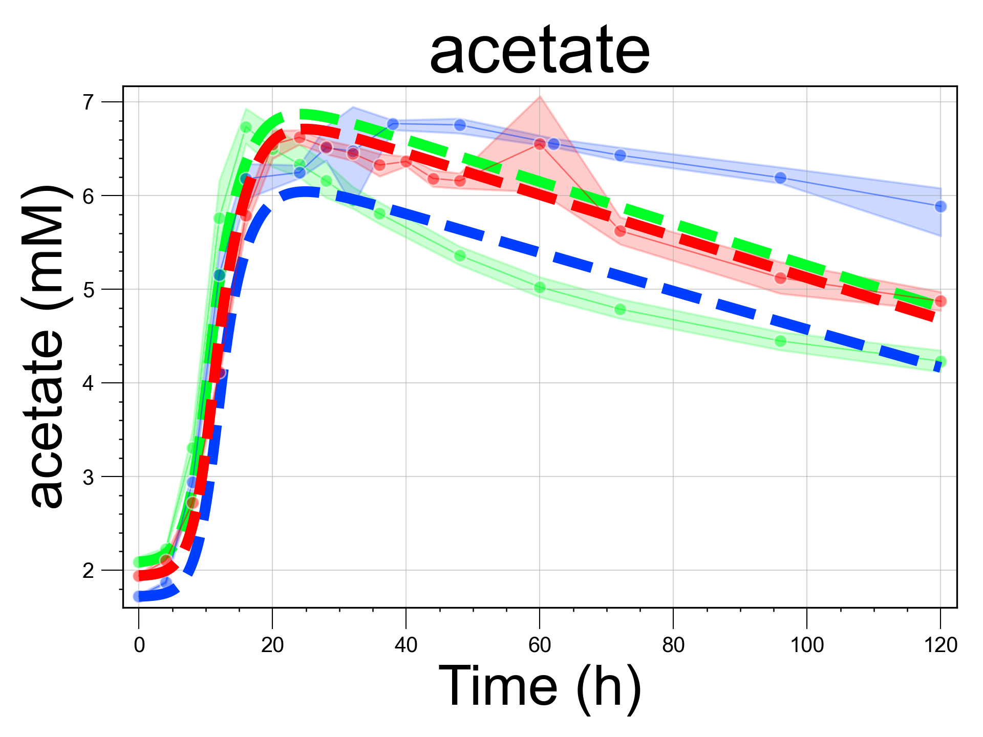
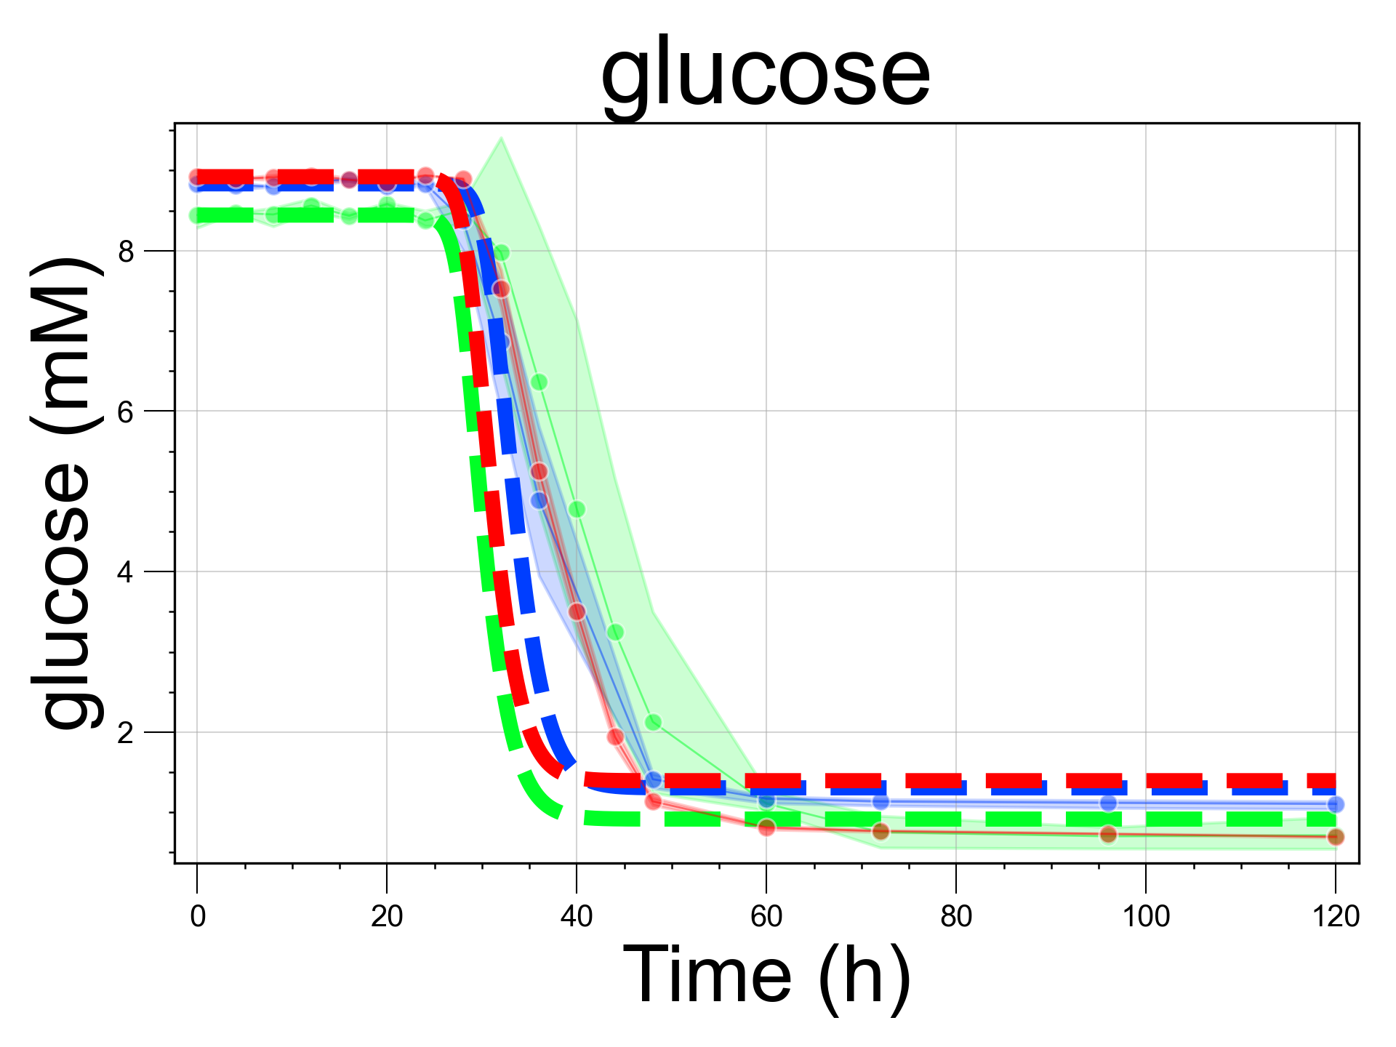
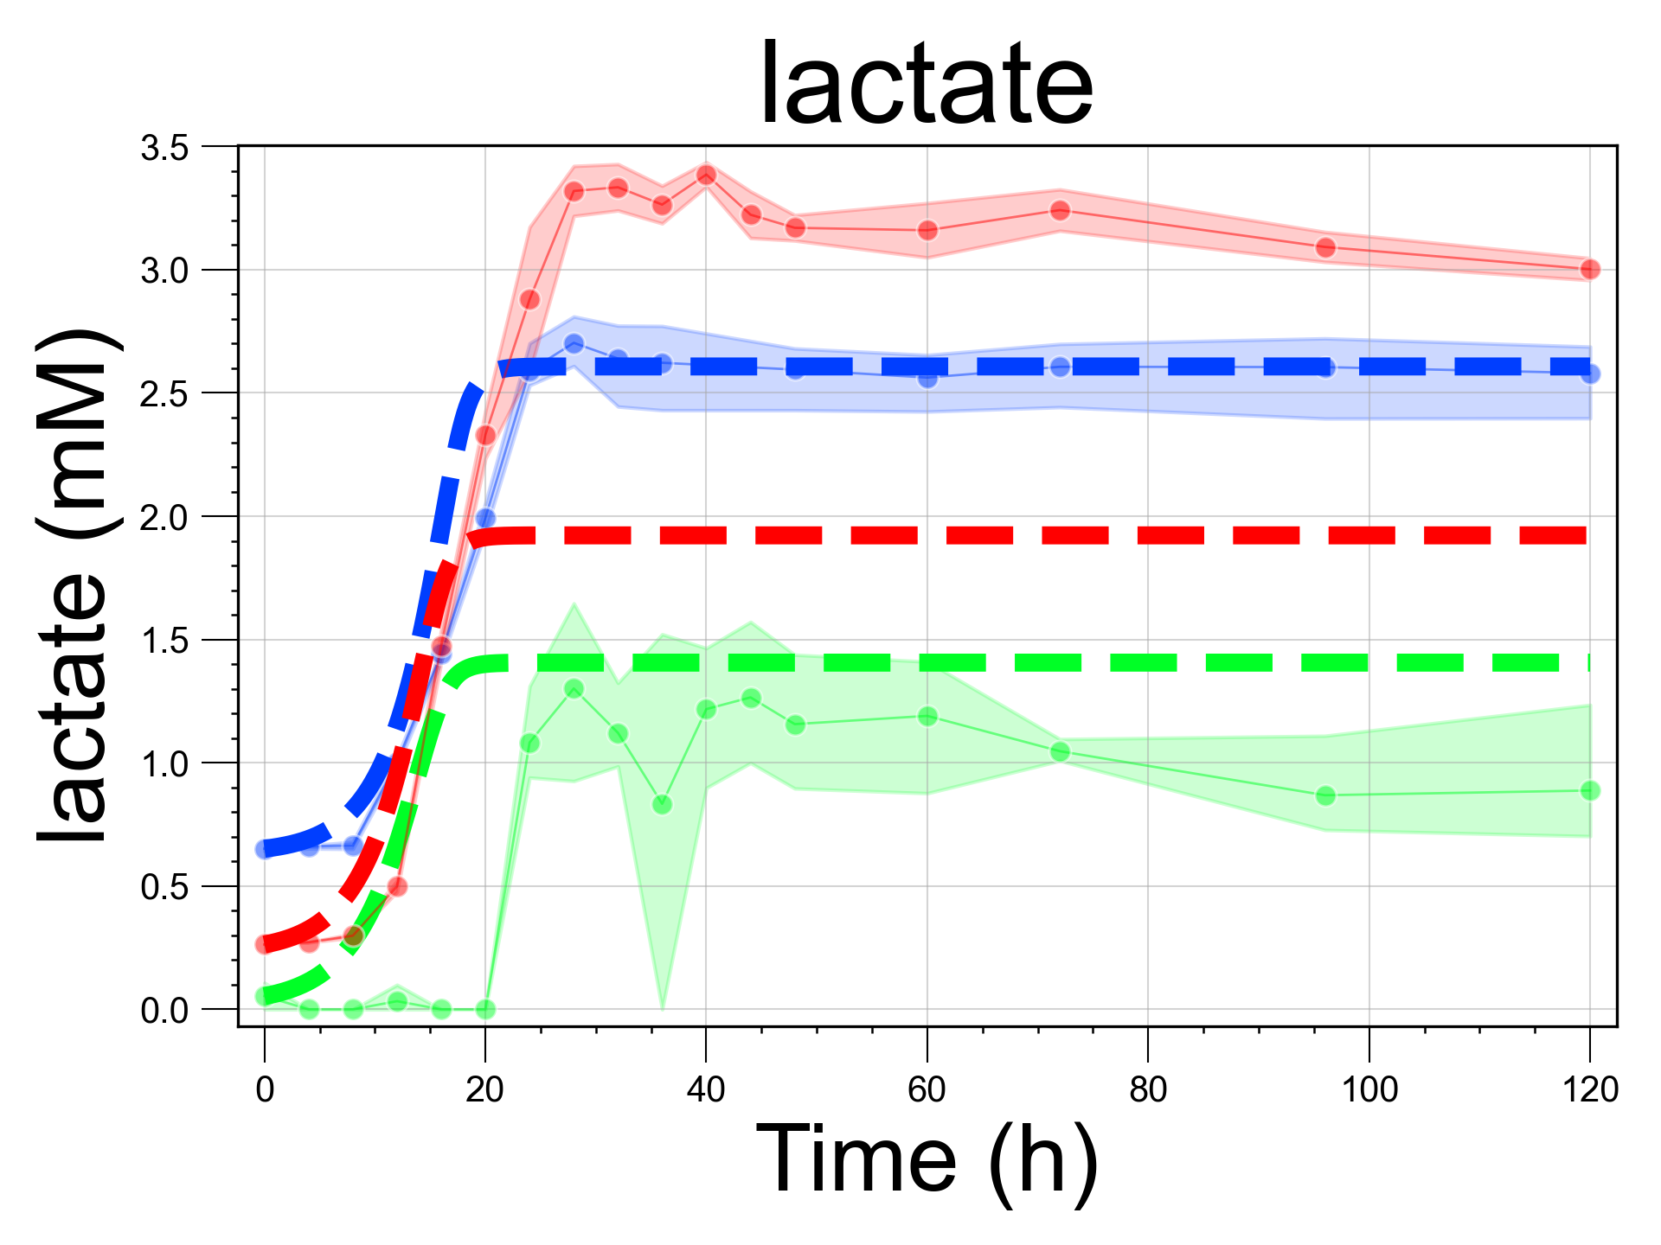
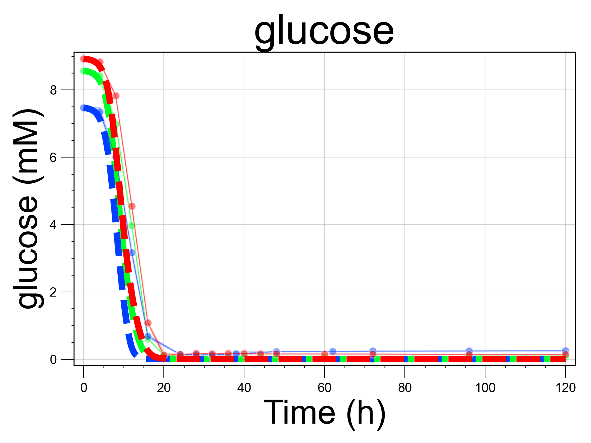
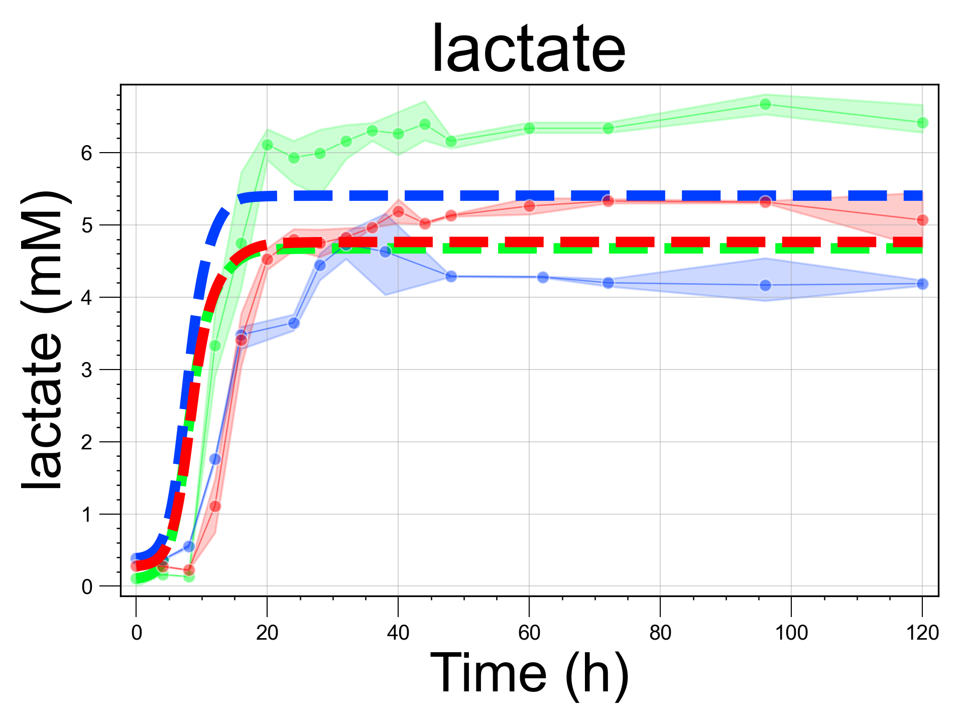
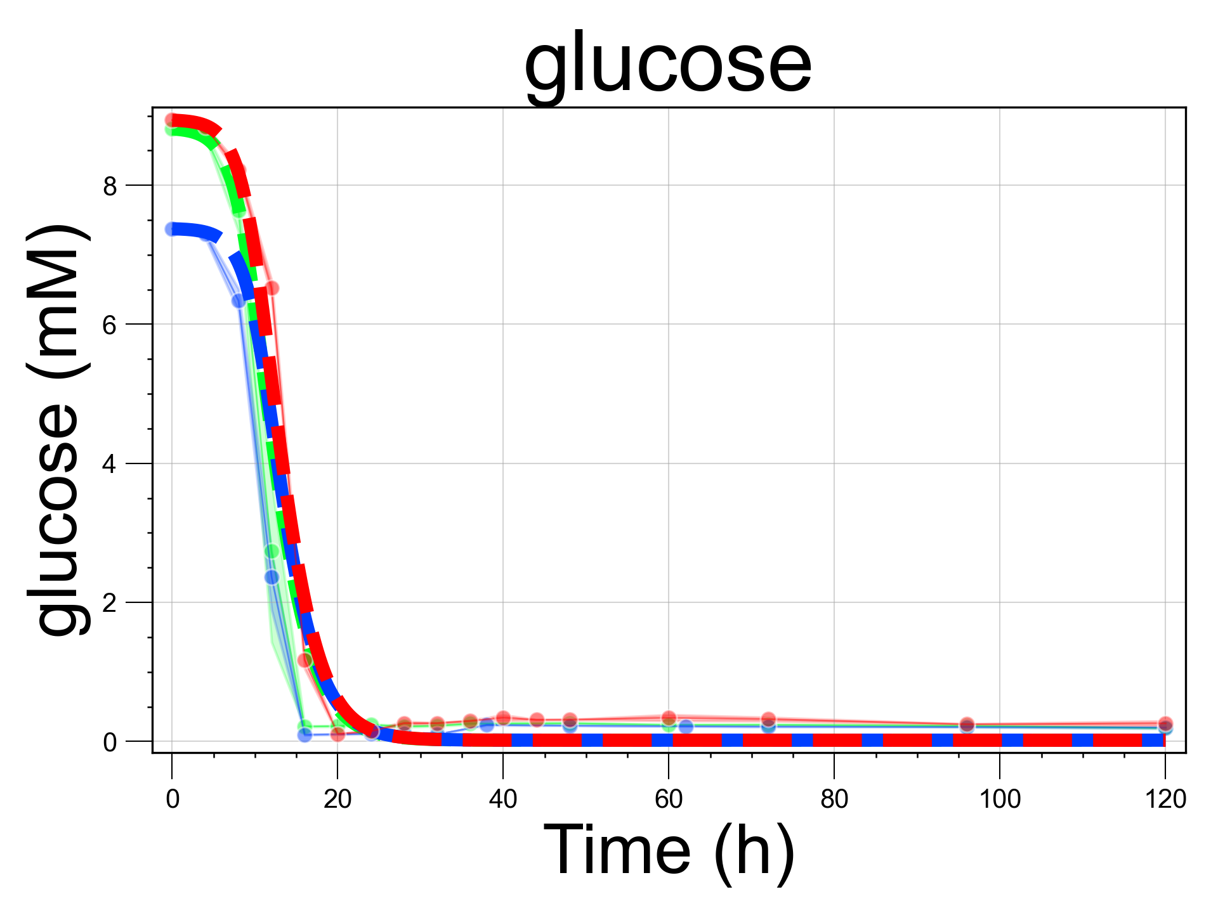
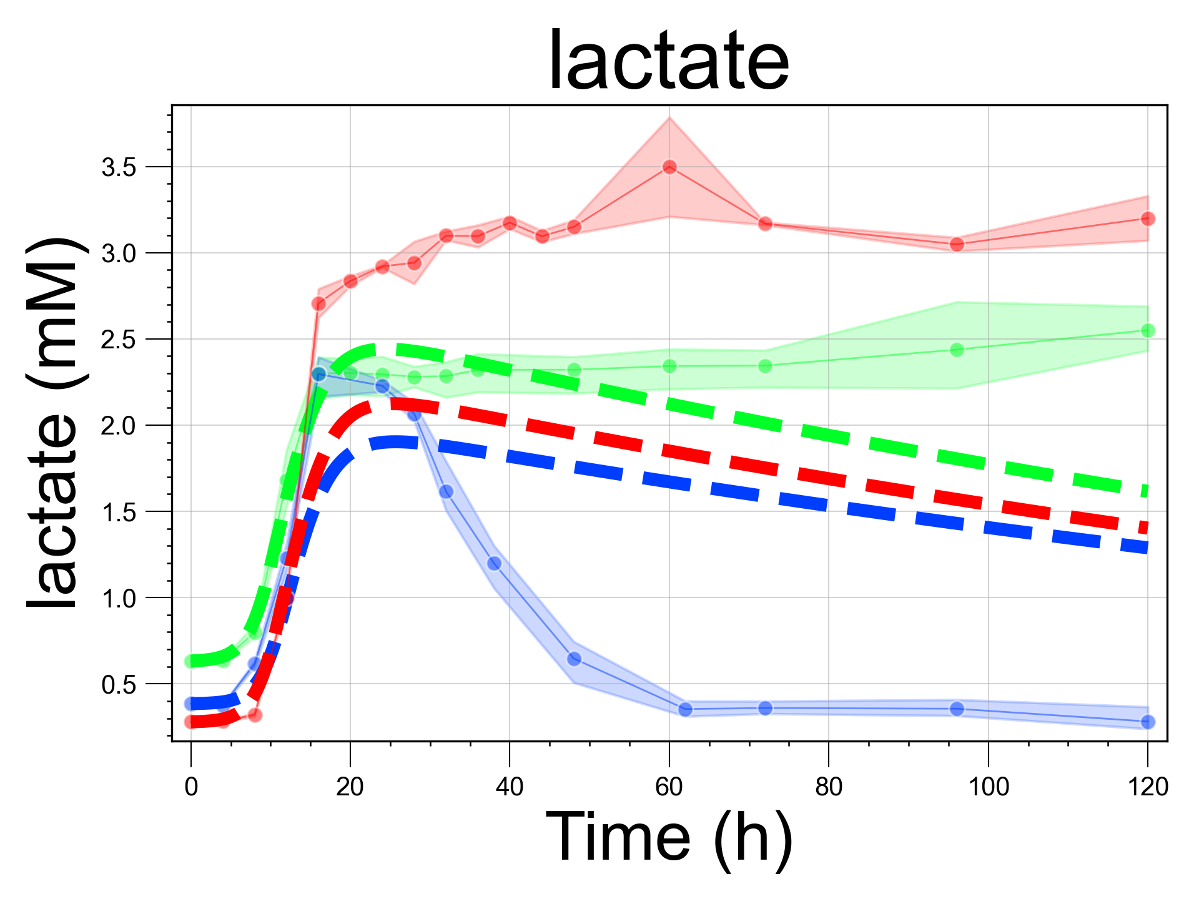
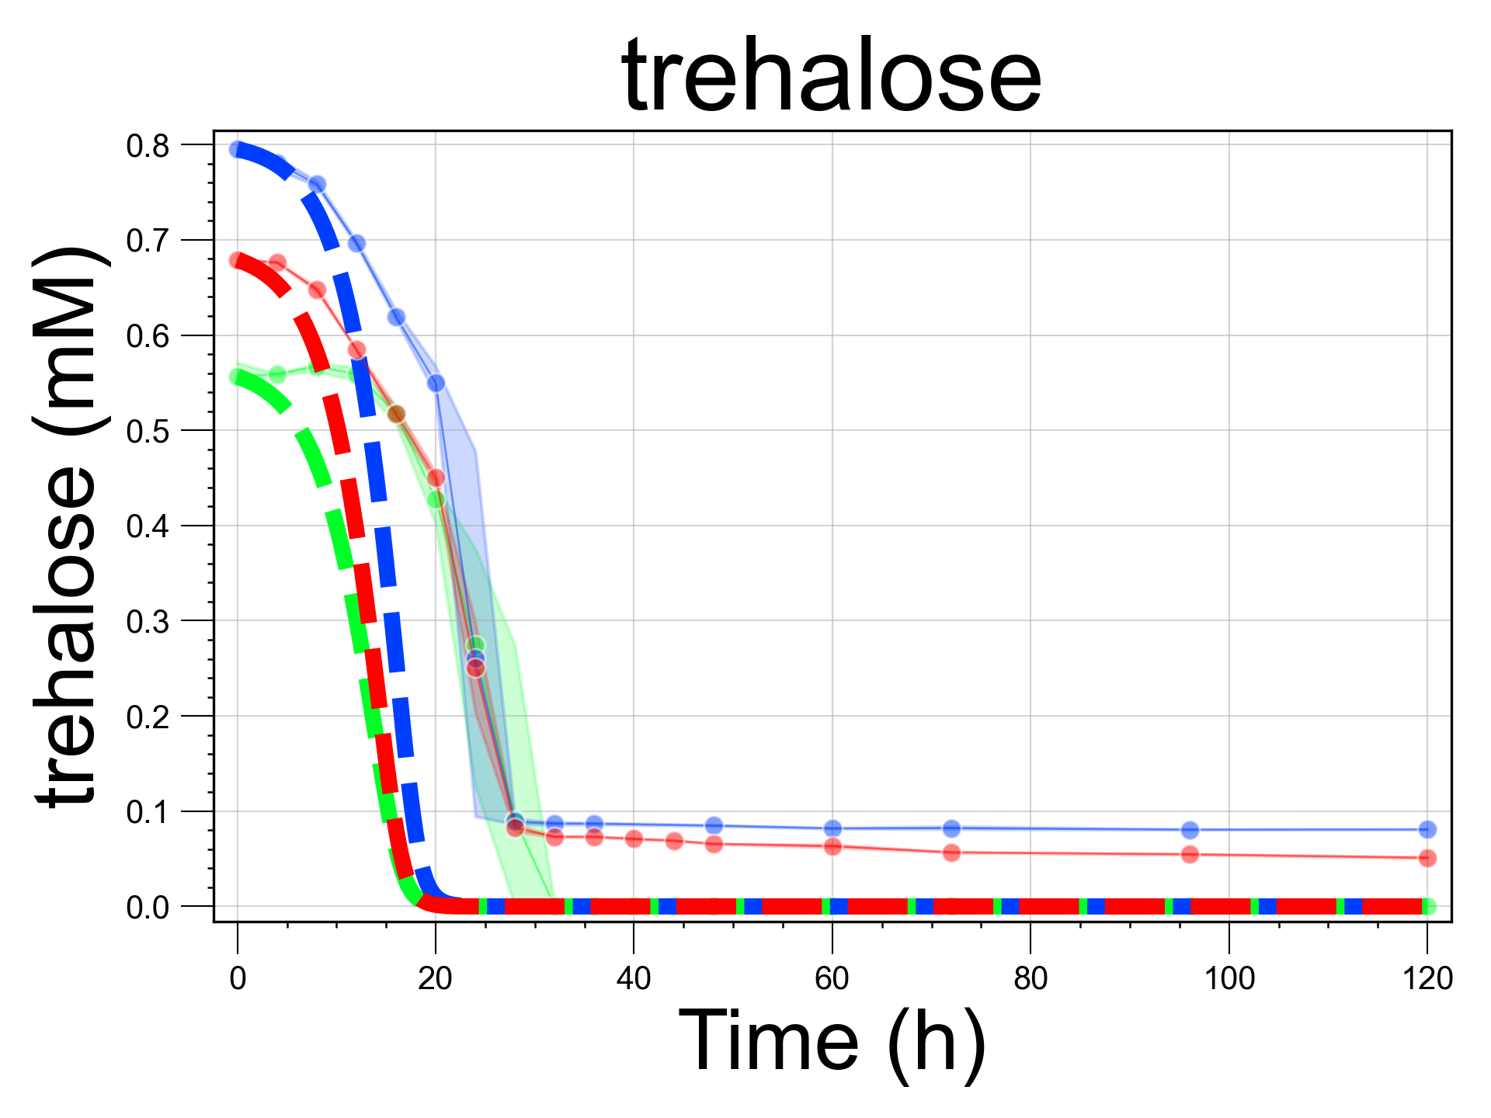
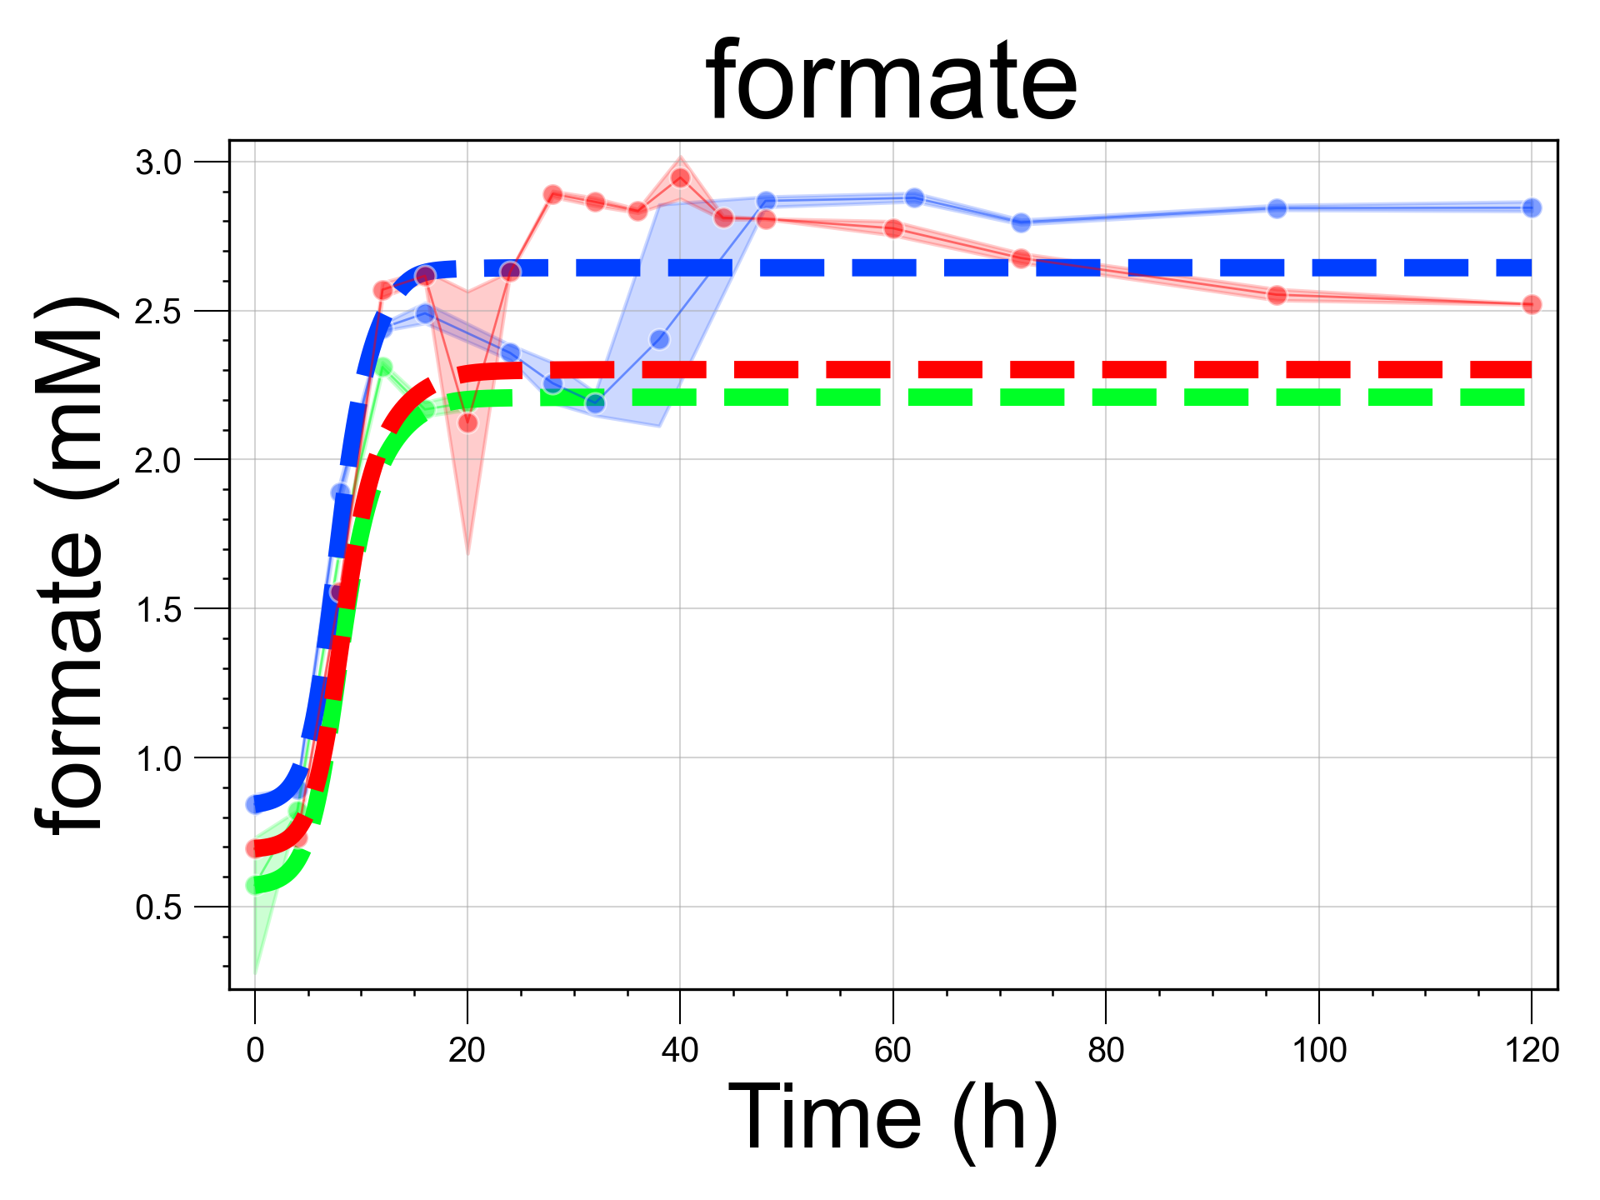
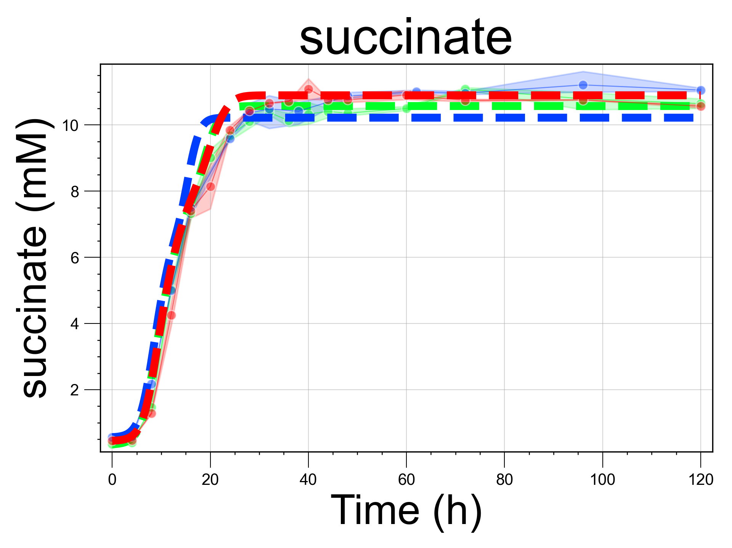
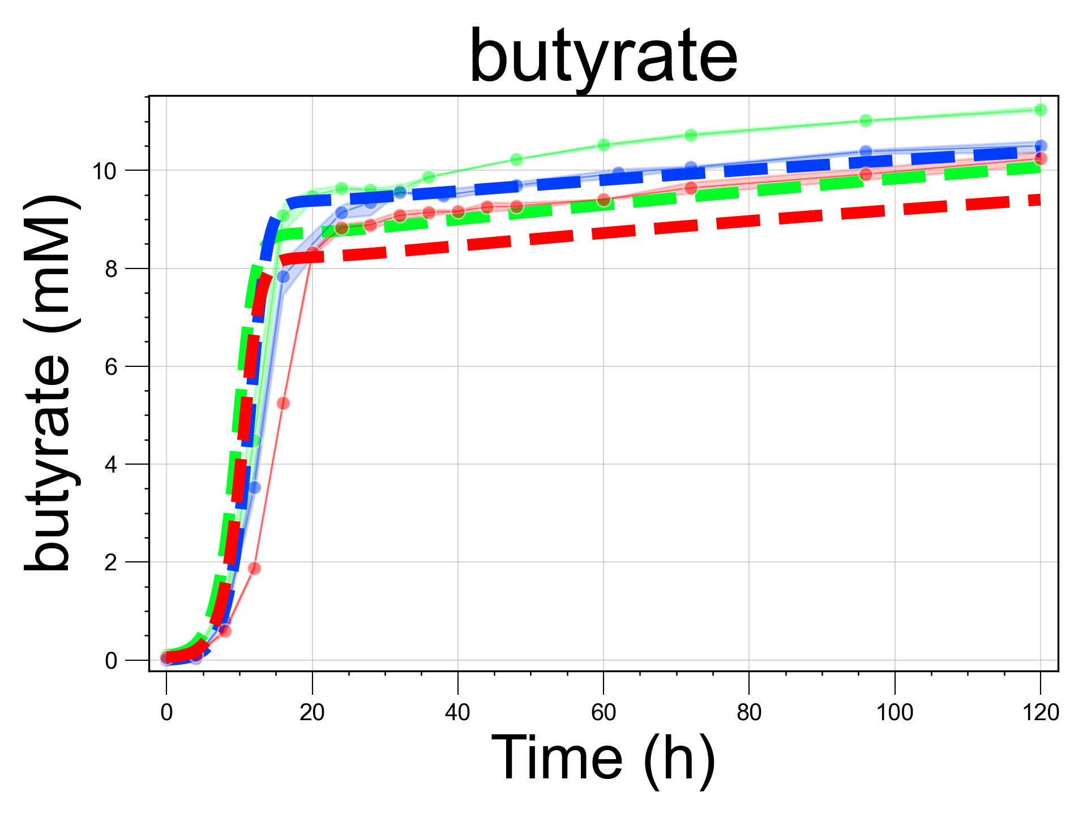
A
B
C
Blautia hydrogenotrophica
Bacteroides thetaiotaomicron
Roseburia intestinalis
D
E
F
Experiment 1
Simulation 1
Experiment 2
Simulation 2
Experiment 3
Simulation 3
Notes:
Exp. data

Slide 3
Figure 1: Growth kinetics and modeled metabolism of three human gut bacteria. Schematic illustration of the core energy metabolism of Blautia hydrogenotrophica (A), Bacteroides thetaiotaomicron (B), and Roseburia intestinalis (C), as inferred from genomic metabolic model reconstructions and empirical growth data. It includes gene expression changes during cultivation (middle panel: correspondent gene names match with their reactions in the upper panel, hypotheses tests estimated with DEseq2), consumption of carbon sources (glucose, pyruvate, trehalose, etc.) and the production of fermentation products (acetate, lactate, butyrate, etc.). Panels D-F compare experimental growth data over time with model simulations (represented by dashed lines) for the three species cultured in WC medium. The growth data represents averages from three independent monoculture experiments, each with 3-6 biological replicates. Simulation initial conditions were the same as the experimental setups.

Slide 4
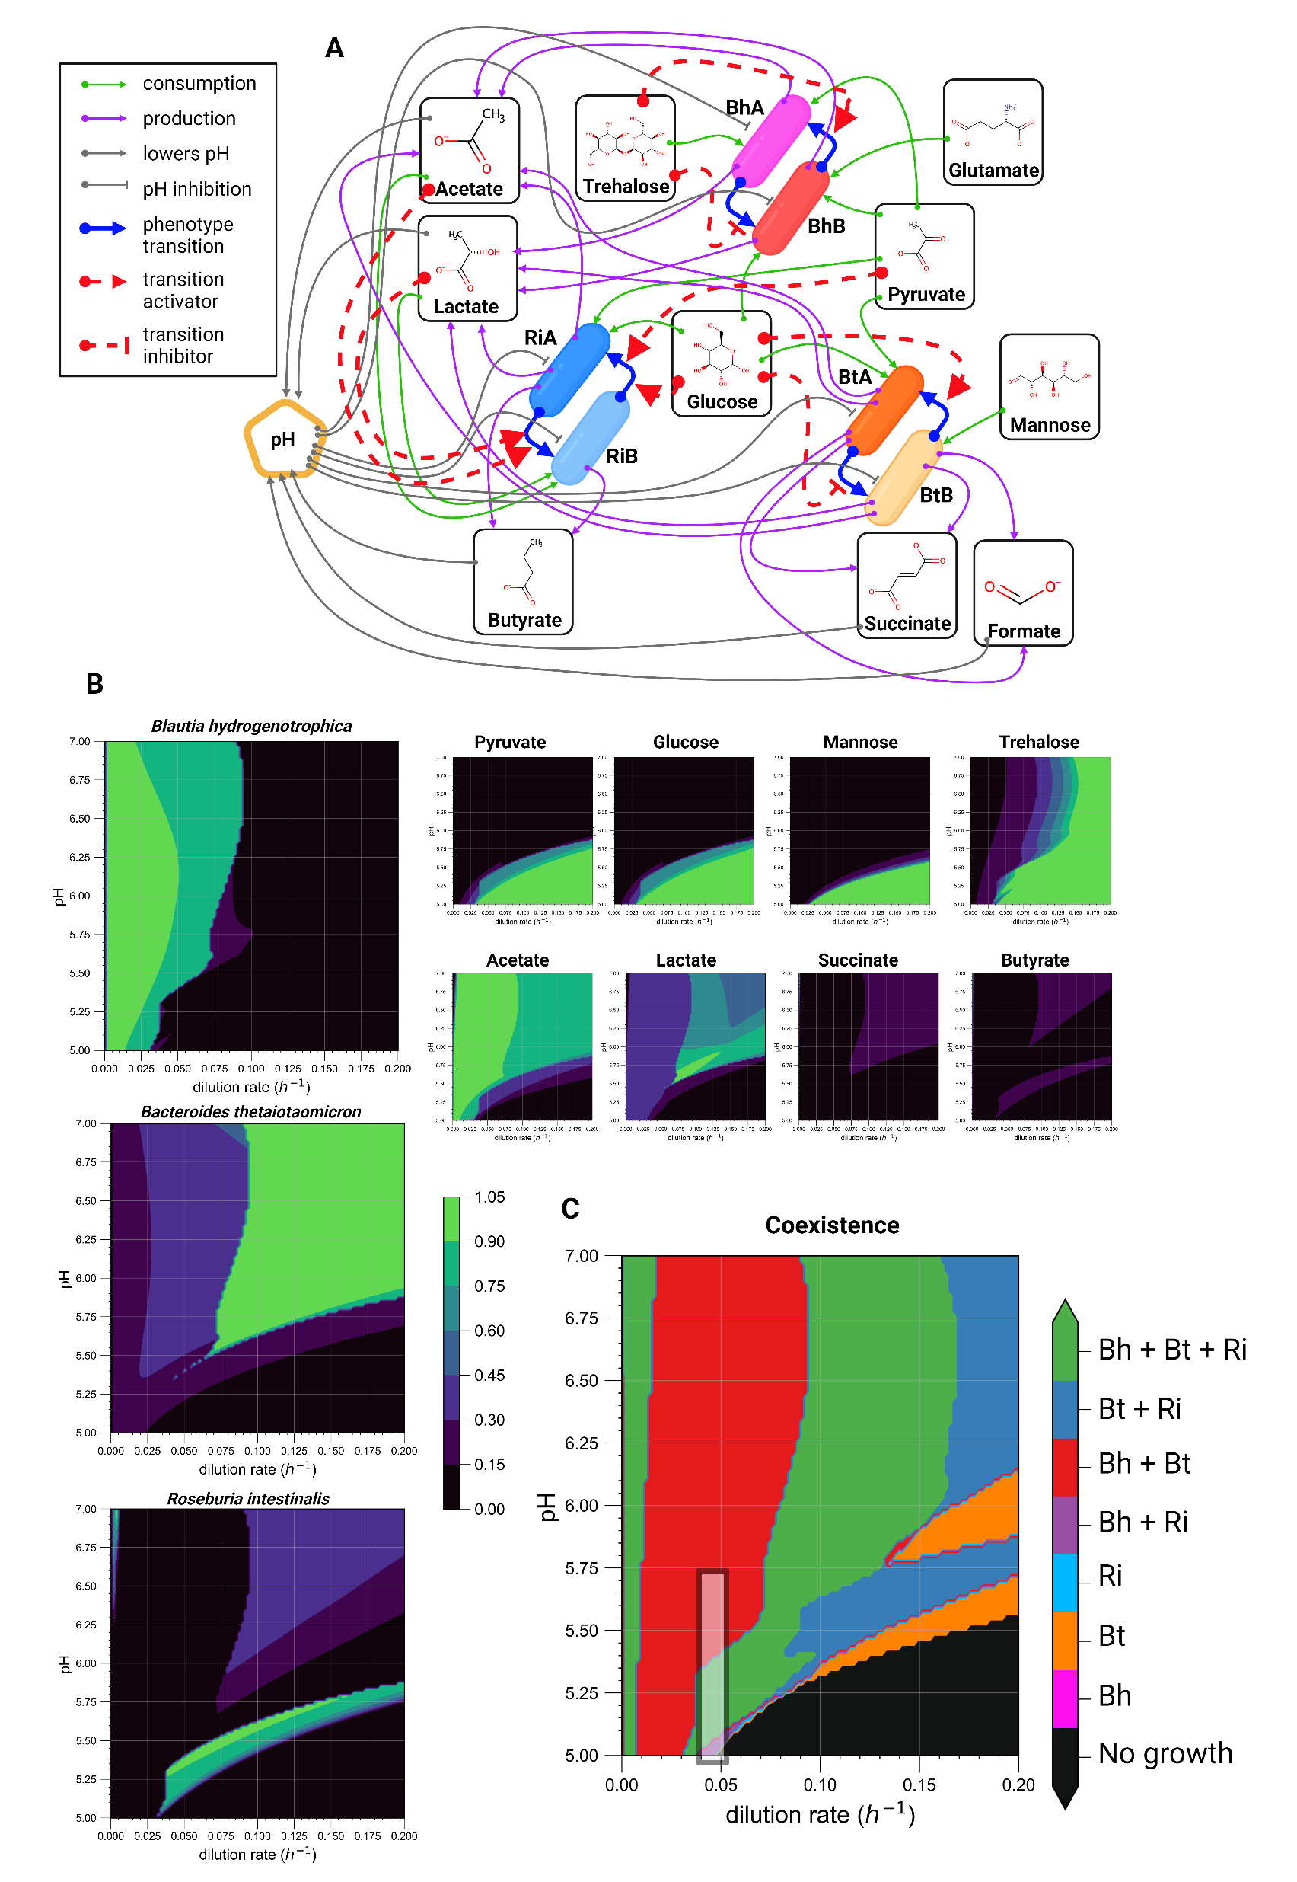

Slide 5
Figure 2: Mechanistic modeling reveals that pH and dilution rate drive community transitions. (A) Schematic of the mechanistic model encoded as ordinary differential equations (see Supplementary Text 1). The model incorporates experimental data (refer to Figure 1B-D and Supplementary Figures S1 & S2) to simulate variables under varying conditions. (B) Contour plots depicting the predicted steady-state concentrations of model variables across a pH range of 5.0-6.5 and dilution rates from 0 to 0.2 h⁻¹. Concentrations, initially in mM for metabolites an in 10⁵ cells/uL for cells, are normalized to their maximum values for comparative purposes. (C) A community composition phase plot indicates the presence or absence of species across different pH and dilution rate conditions. A species is considered present if its steady-state concentration exceeds 0.01 x 10⁵ cells/μL. The black shaded rectangle within the plot highlights the conditions that closely approximate those of our mini-bioreactor experiments (refer to Figure 3).

Slide 6
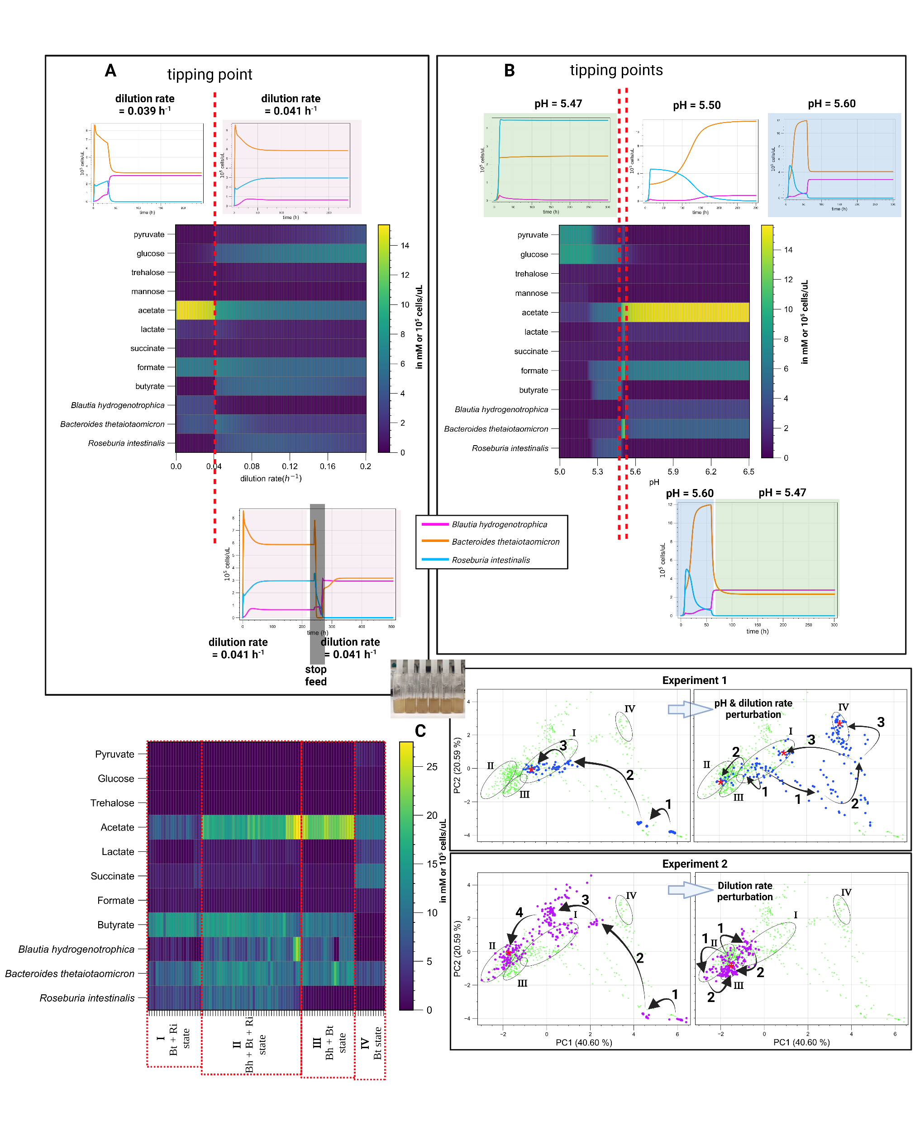

Slide 7
Figure 3: Modeling and experimental validation of tipping points and multistability in a gut microbial community. Model simulations predict alternative steady states connected by sharp transitions (tipping points) that exhibit hysteresis (ecological memory). For example, (A) a perturbation of the dilution rate drives the community towards an alternative state. Even when the original dilution rate is restored, indicated by the pink background, the system does not return to its previous state. (B) The steady-state community composition that emerges when controlling the system’s pH depends on the system’s history. For example, a different state is reached when the system starts and remains at a pH of 5.47 (indicated by the green background) compared to when it starts at a pH of 5.6 and is shifted to a pH of 5.47. (C) Experimental validation conducted in minibioreactors (shown in the small inset photograph) reveals sharply defined, stable community compositions that persist under nearly identical environmental conditions, aligning with the model's predictions of multistability. We systematically collected periodic samples and analyzed community-state using HPLC for metabolites, alongside 16S rDNA sequencing and flow cytometry for bacterial species quantification (detailed in Supplementary Table S2). The heatmap illustrates the endpoint replicates before perturbation and after achieving a post-perturbation steady-state, classified by “states” corresponding to the ellipses I, II, III, and IV in the PCA plots. The ellipses were drawn as the minimal ellipses that enclose all the endpoint samples depicted in the heatmap. The top and bottom plots track the trajectories of two separate experiments within principal component space. The left plots depict the paths taken by samples towards their steady-states, starting at “1” and progressing until they reach a point of minimal change (“3”); the approximate location of their steady-states are denoted by red asterisks within the ellipses. The right plots trace perturbation and post-perturbation trajectories: in the first experiment (blue dots), samples transition from steady-state I, which is dominated by Bacteroides thetaiotaomicron and Roseburia intestinalis, to one of three alternative states (either remaining in I, going to II where all three species coexist, or to IV where Bacteroides thetaiotaomicron dominates). In the second experiment (purple dots), exposed only to a dilution rate perturbation, samples transition from state II to state III, which is dominated by Bacteroides thetaiotaomicron and Blautia hydrogenotrophica. The light green PCA points in the background comprise all samples; The complete temporal trajectory is illustrated in Supplementary Movie S2.

Slide 8
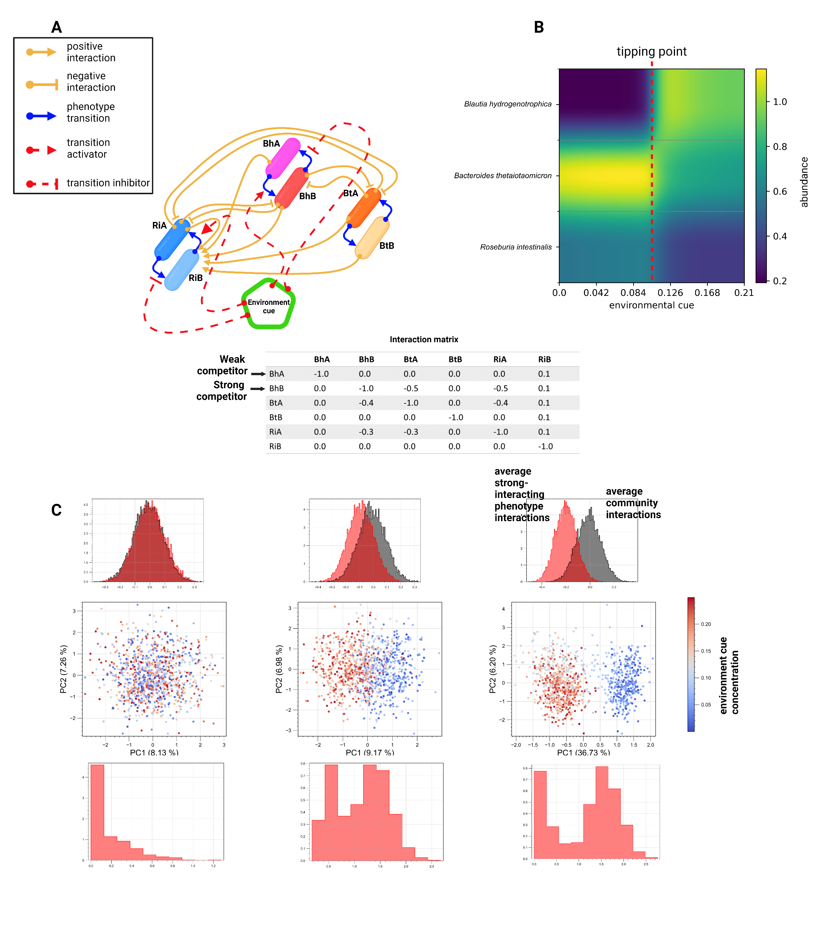

Slide 9
Figure 4: Toy model demonstrates conceptual mechanism for multistability. (A) Species have alternative phenotypes connected by environment-responsive transition functions, implemented through hill-equations, allowing dynamic switching between phenotypes during simulations (refer to Supplementary Text S2 for details). (B) If one phenotype strongly interacts with others (average interaction strengths are higher than the average community interactions), phenotype switching can induce a sharp transition between alternative community states (e.g. high steady-state trehalose leads Blautia hydrogenotrophica to a weakly competing phenotype, but low trehalose triggers a metabolic shift, enabling Blautia hydrogenotrophica to strongly outcompete others). (C) Simulations with 1000 random communities containing 50 species and a random concentration of an environmental factor show this mechanism can explain emergent alternative stable states reminiscent of enterotypes (seem as two distinct clusters in principal component space). Gray histograms show distribution of interaction strengths across communities; red denotes a phenotype-specific strong interactor that emerges in response to the concentration of an environment factor. The lower histograms show the distribution of this species across samples. Notably, when enterotypes emerge, this typing element exhibits a bimodal distribution across samples.

Slide 10
Supplementary Figures

Slide 11
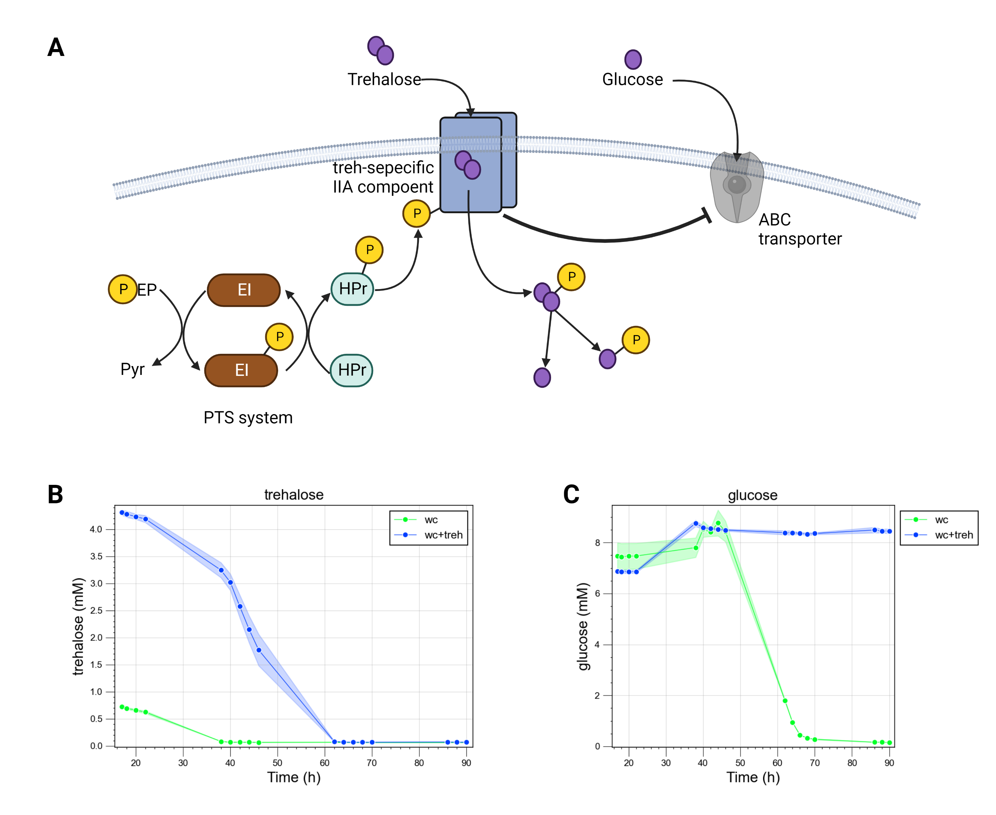
Supplementary Figure S1: Blautia hydrogenotrophica neglects glucose when trehalose is present in the medium. (A) Illustration of a hypothetical PTS system that detects trehalose and inhibits the expression of the ABC transporter responsible for importing glucose. Although the detailed molecular mechanisms of this inhibition have not been fully elucidated, RNAseq data clearly show inhibition of the ABC transporter when trehalose is present (refer to main Figure 1A). Moreover, (B) supplementing WC medium with additional trehalose results in the (C) complete inhibition of glucose consumption (as compared with the 'glucose' plot in Figure 1D).

Slide 12
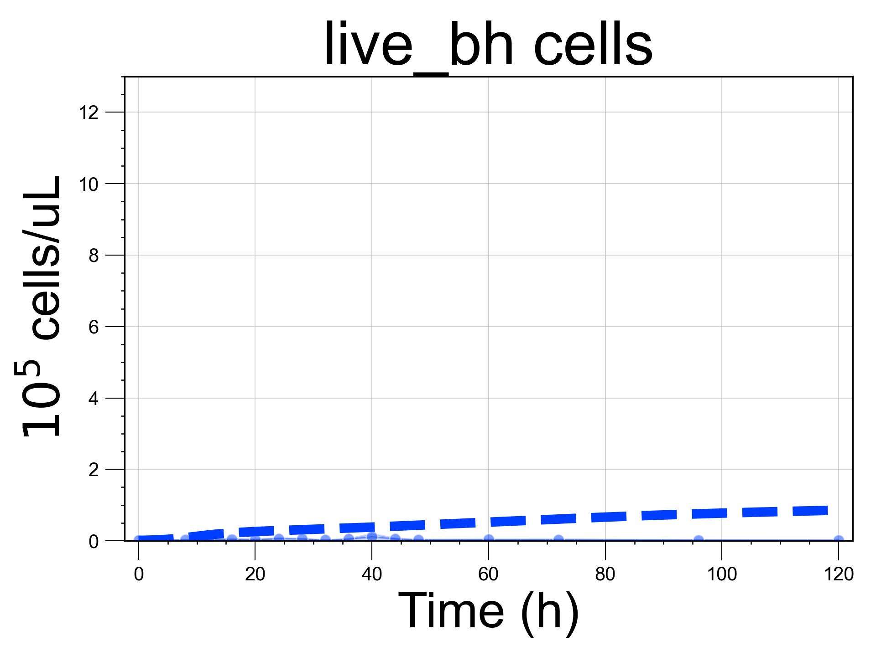
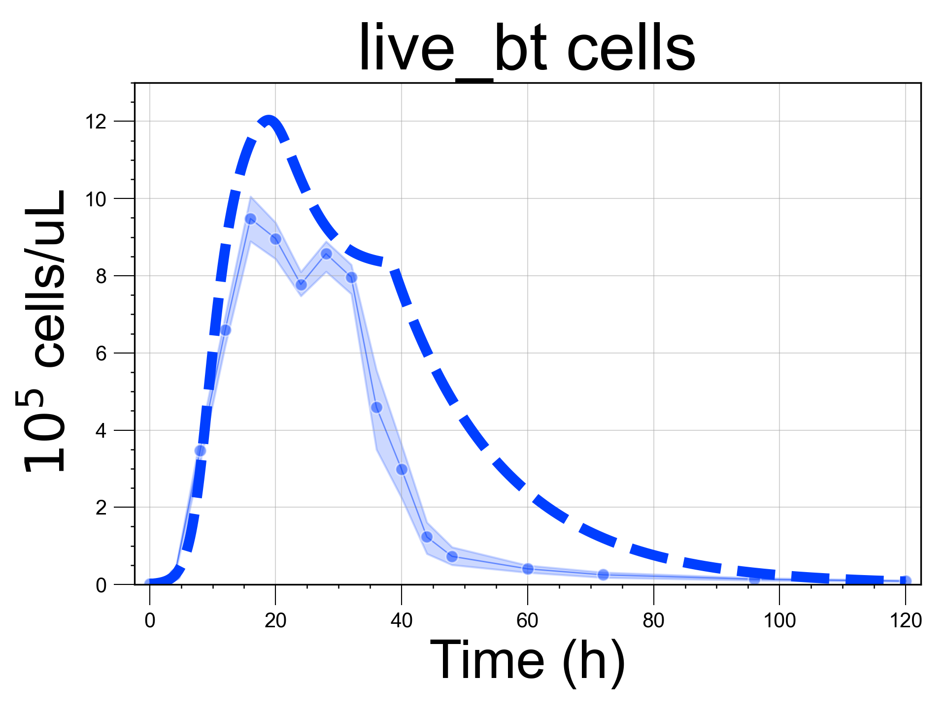
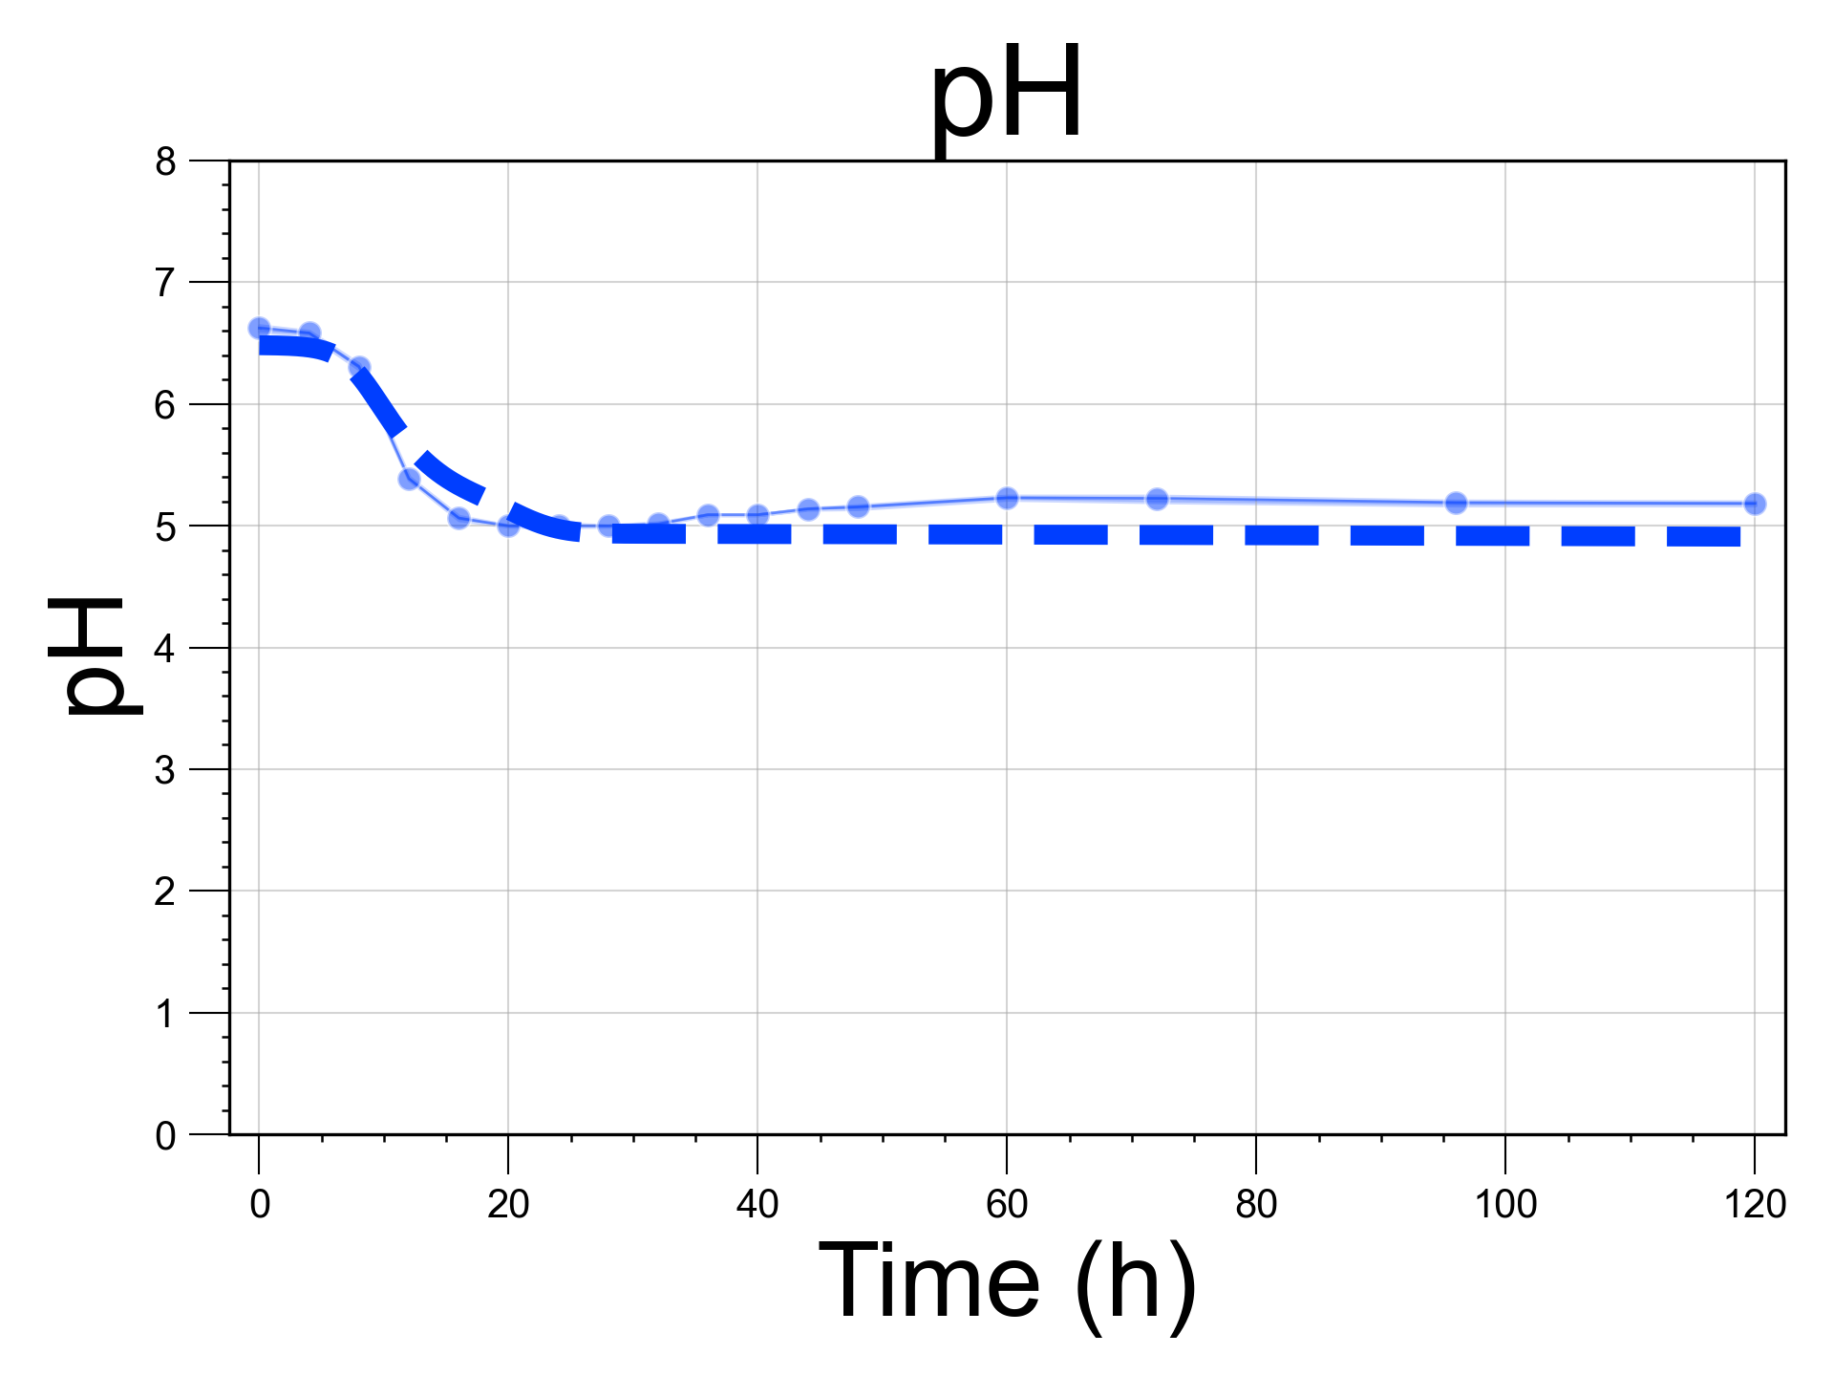
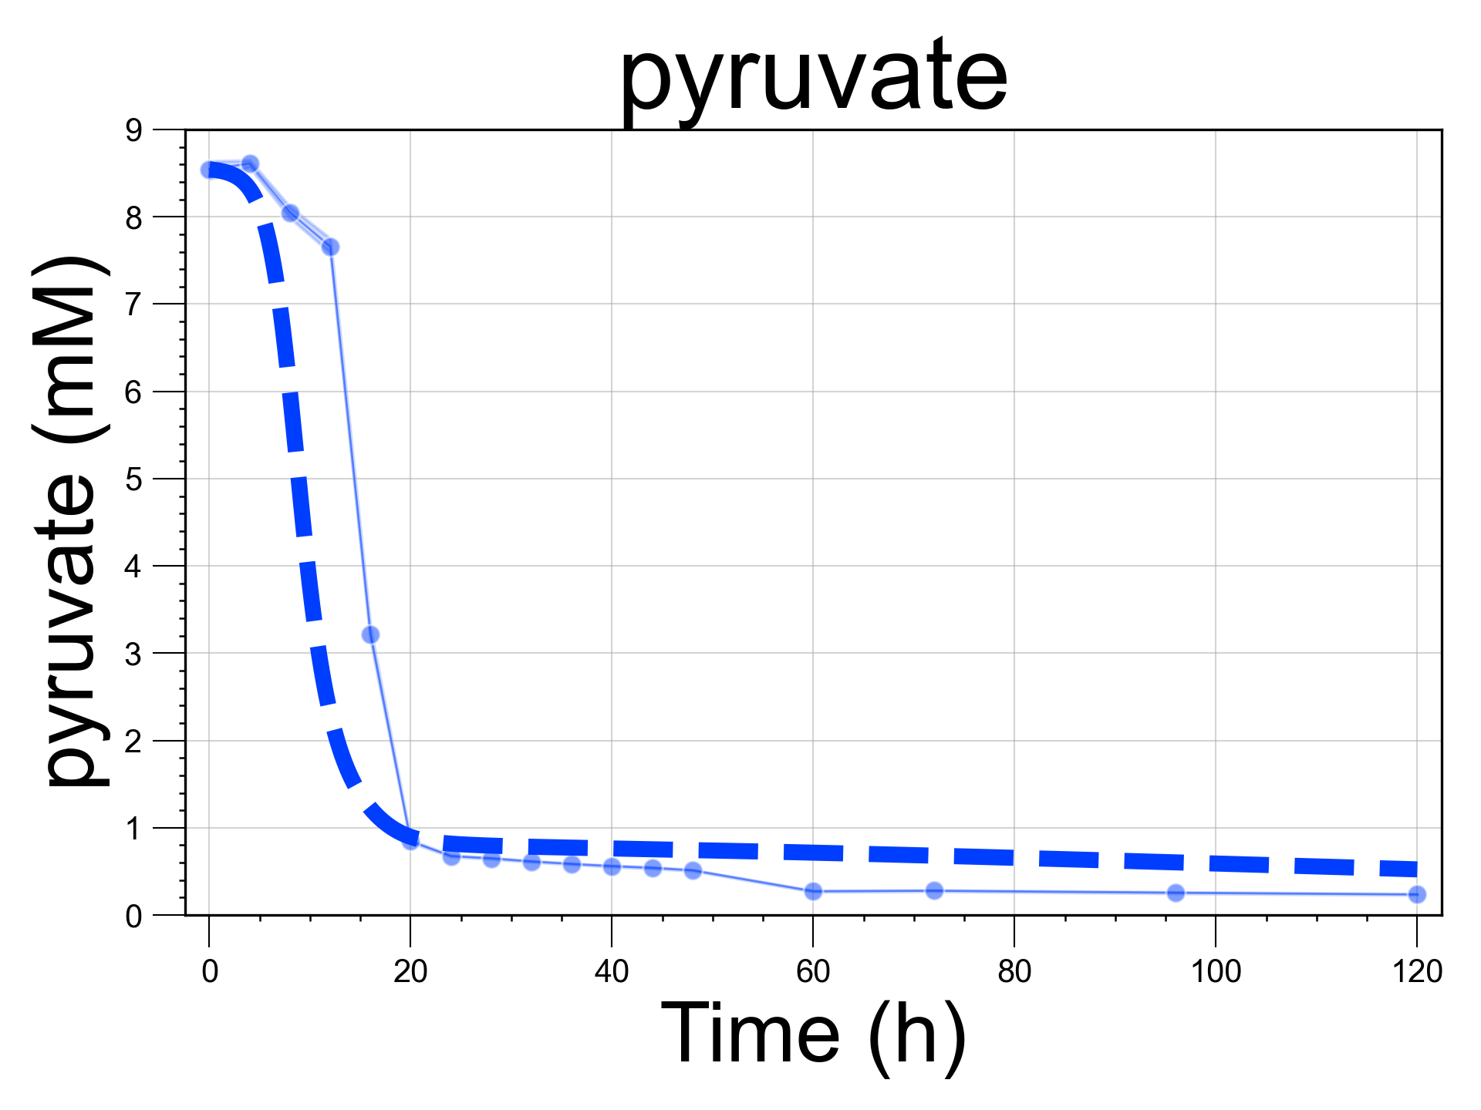
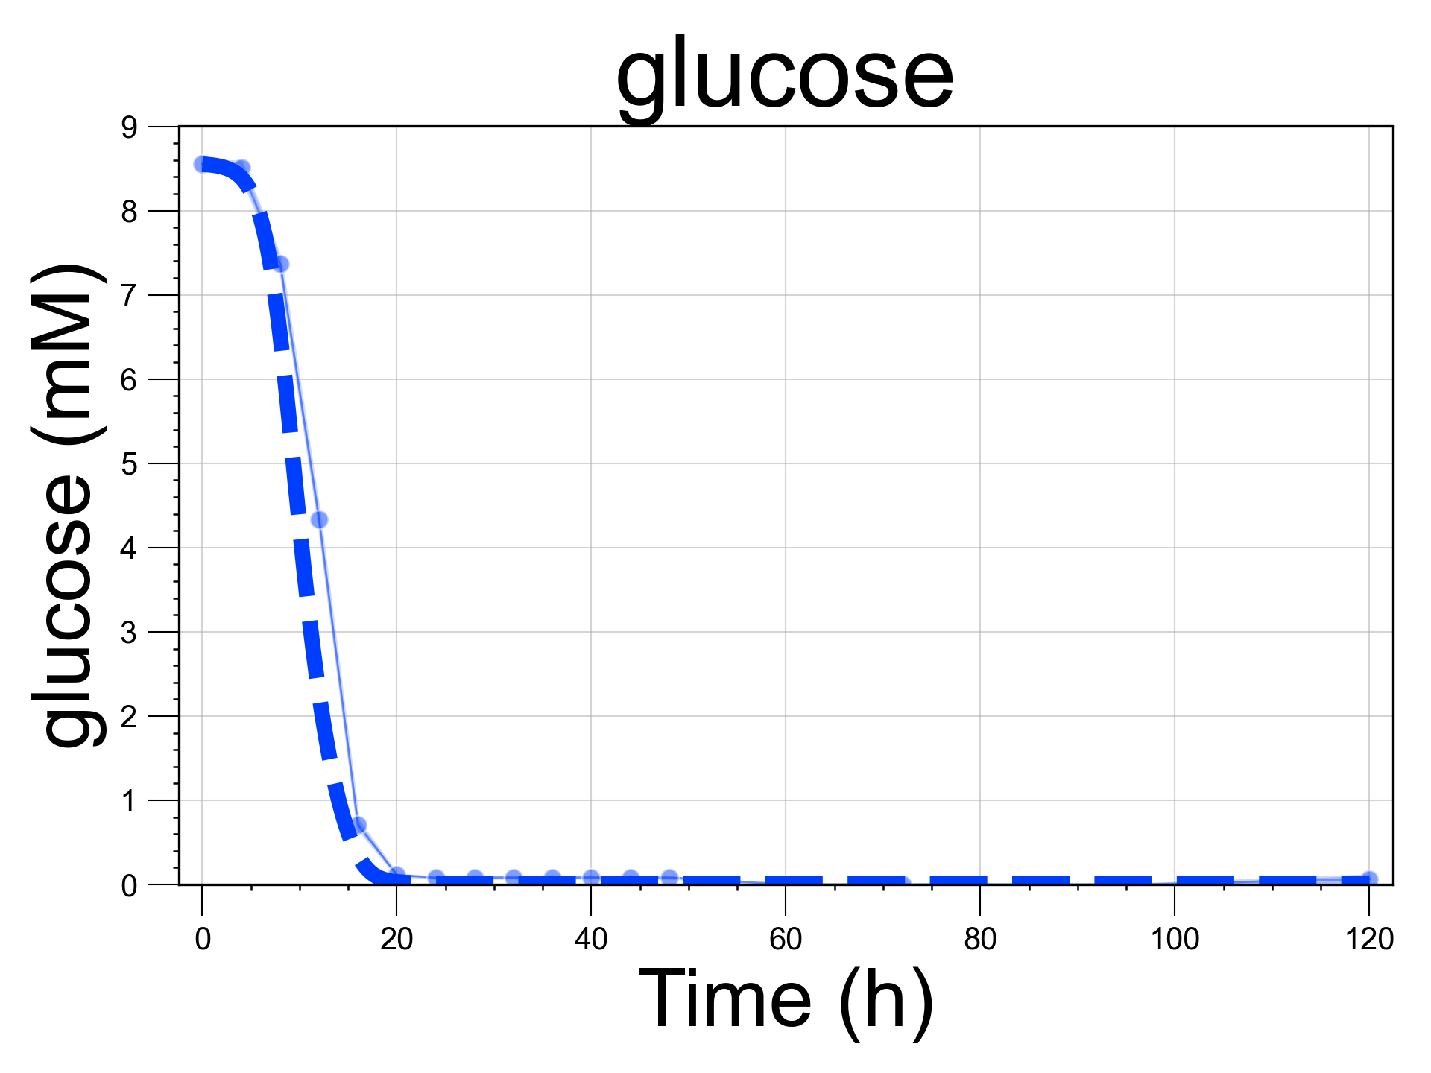
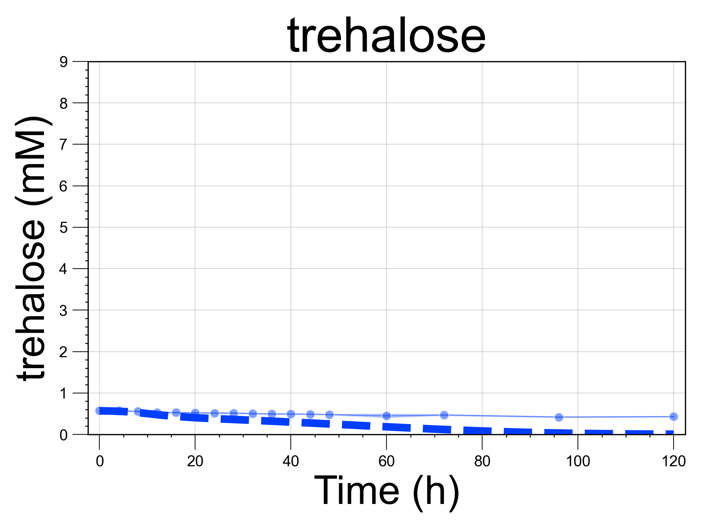
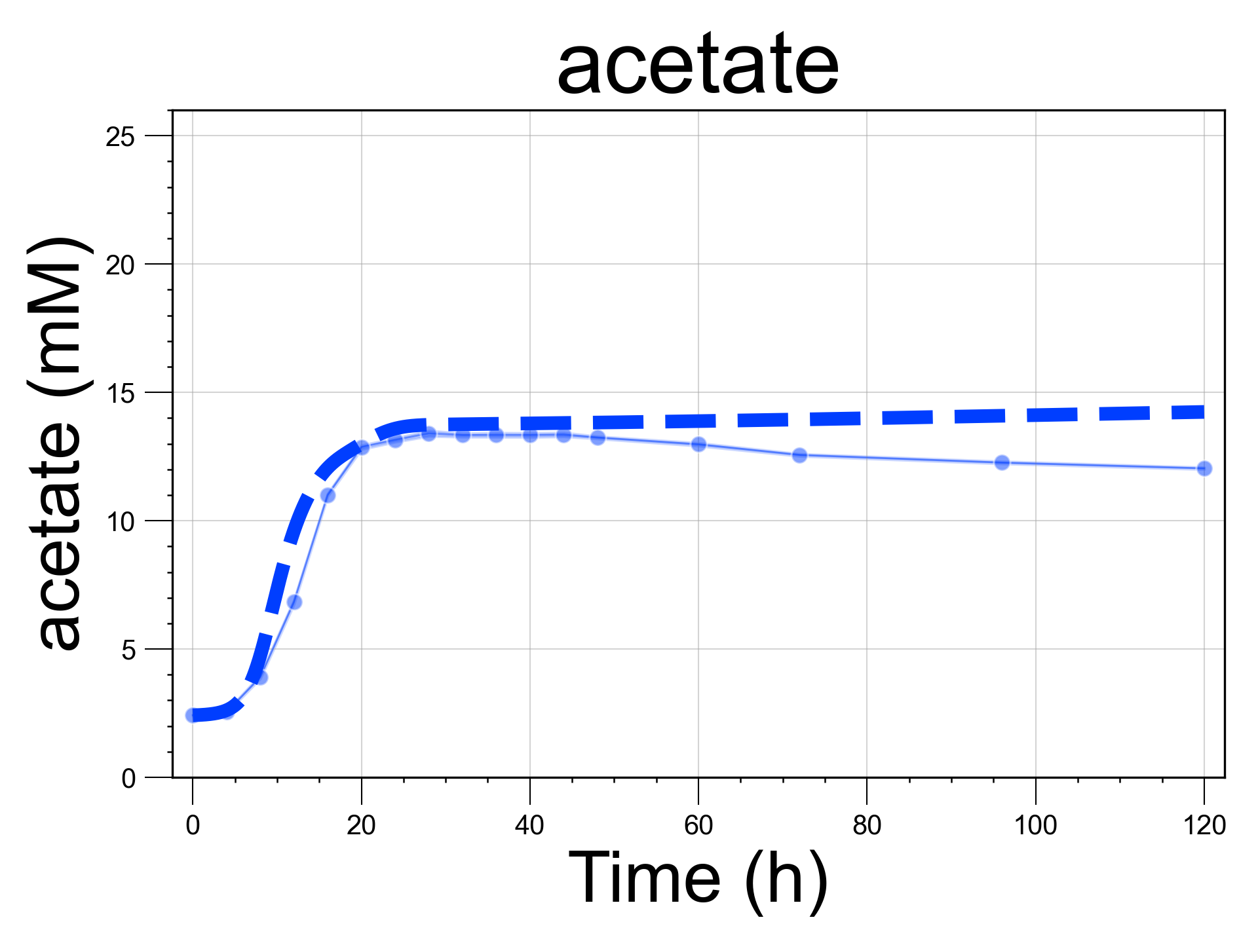
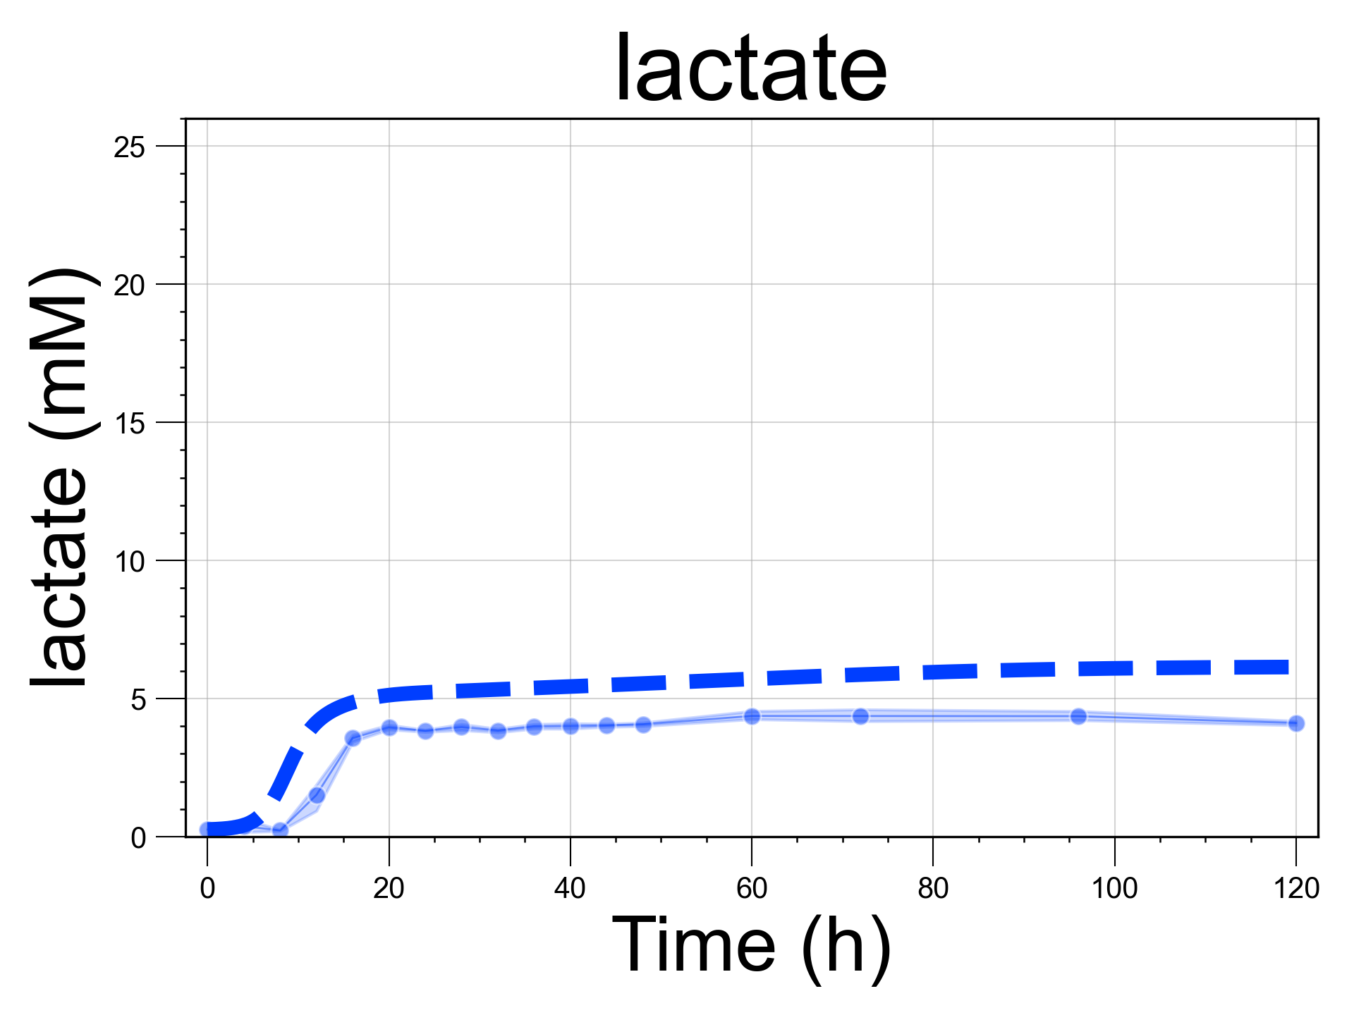
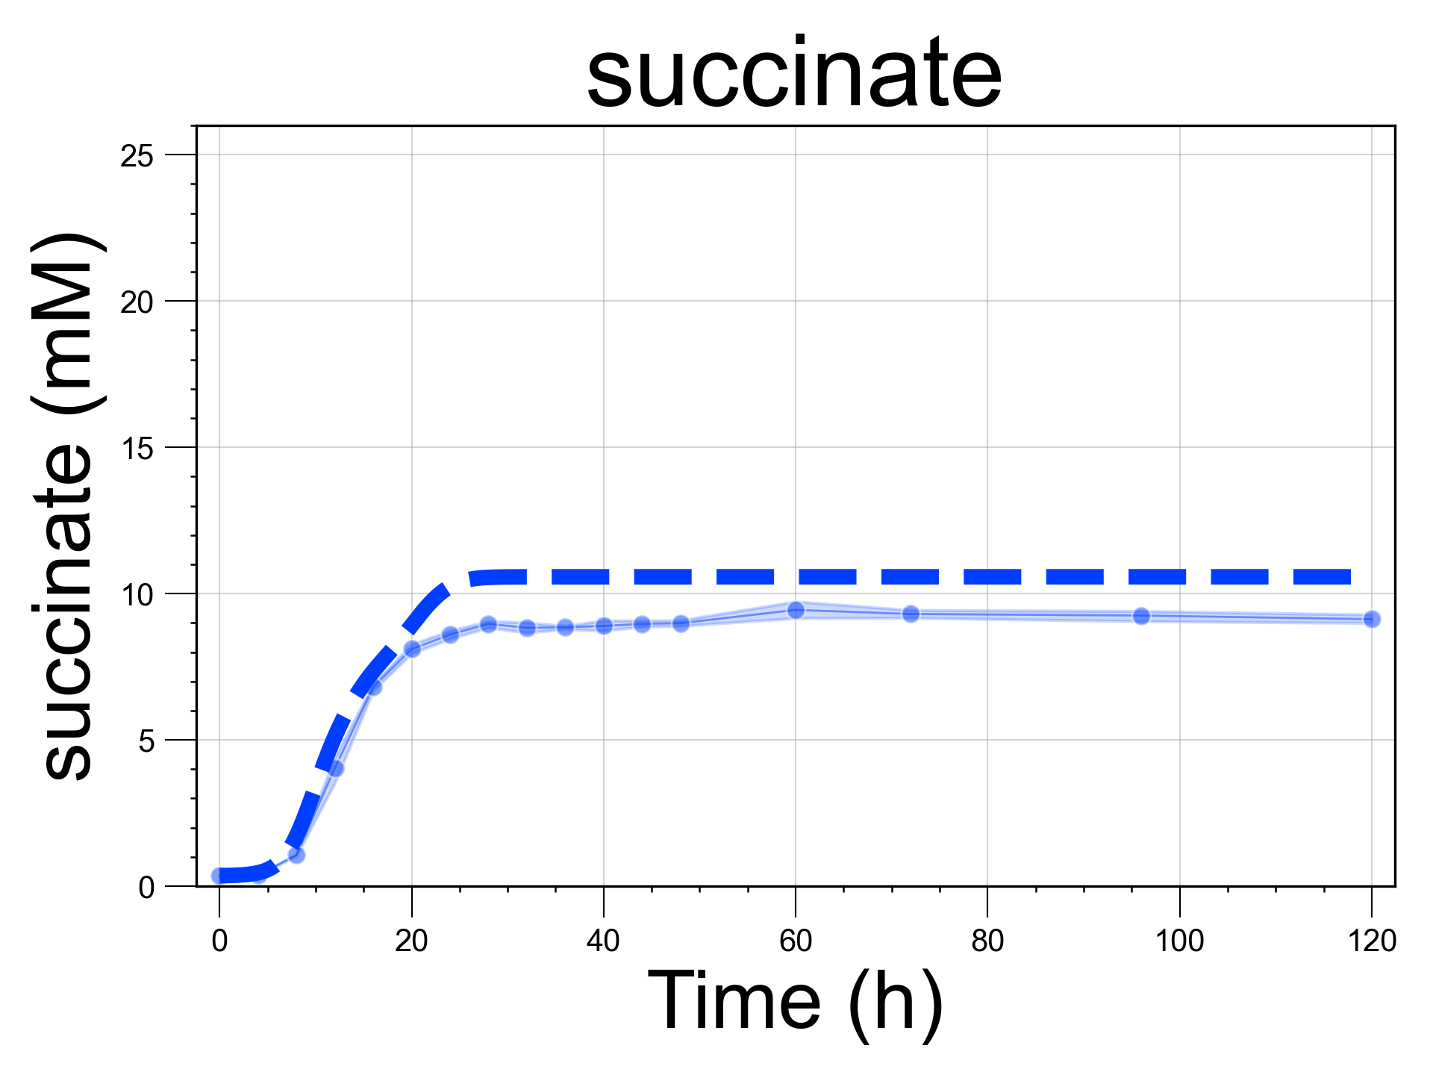
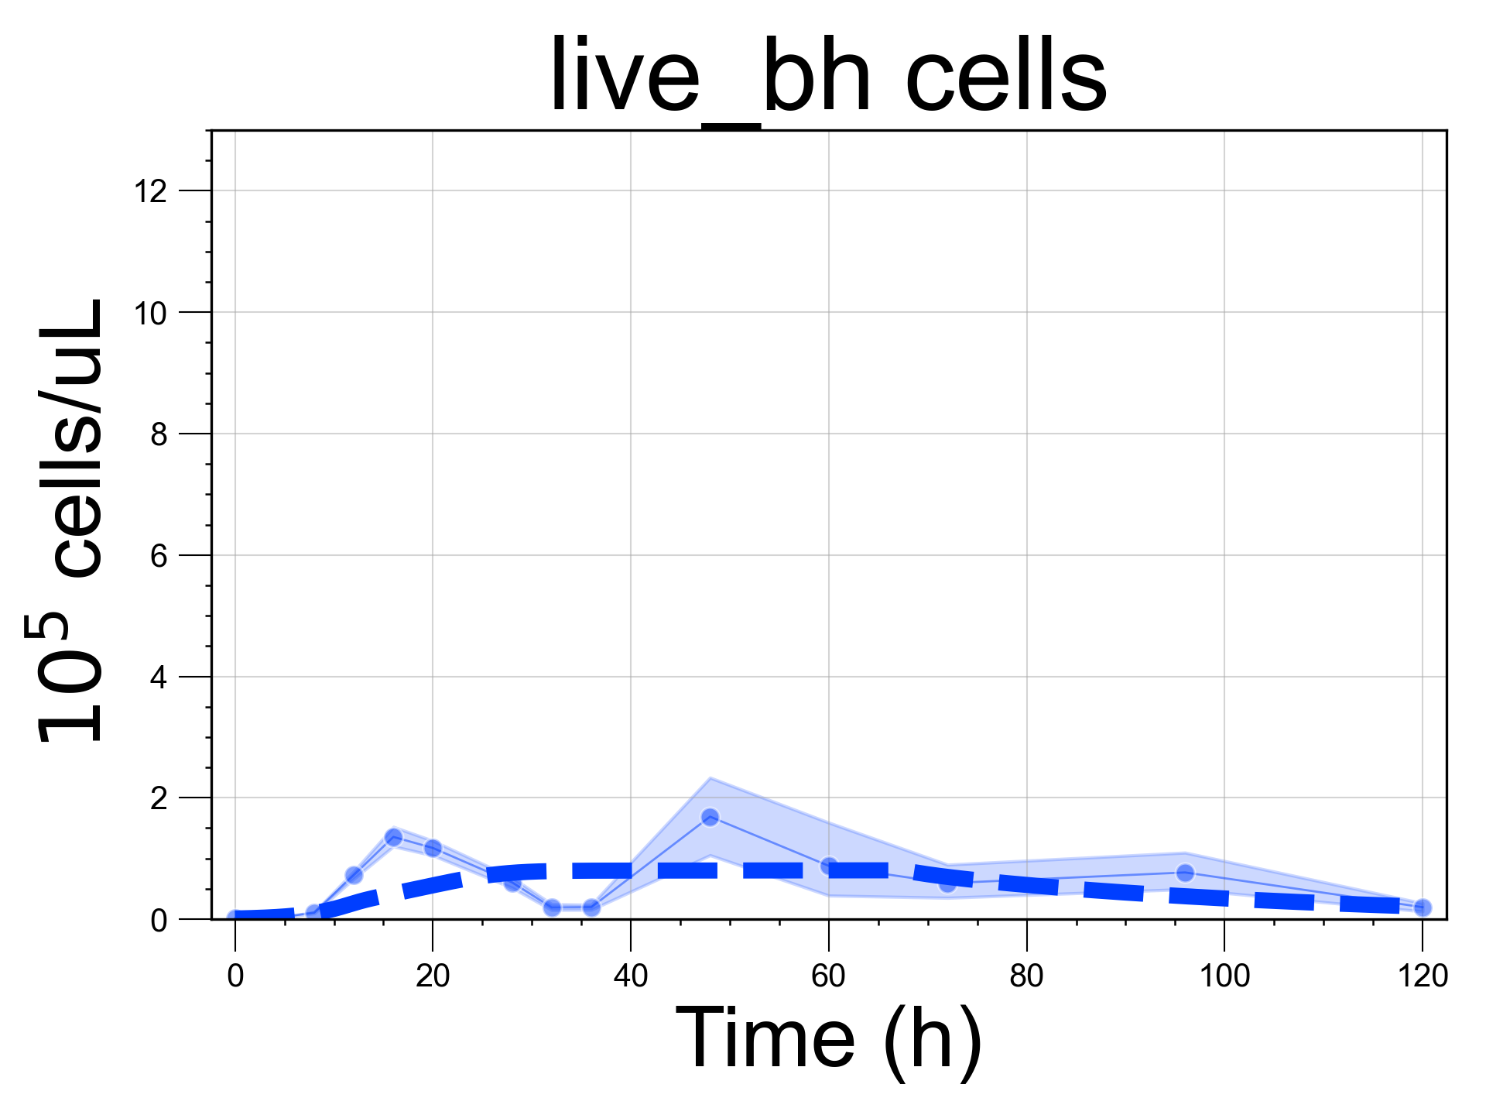
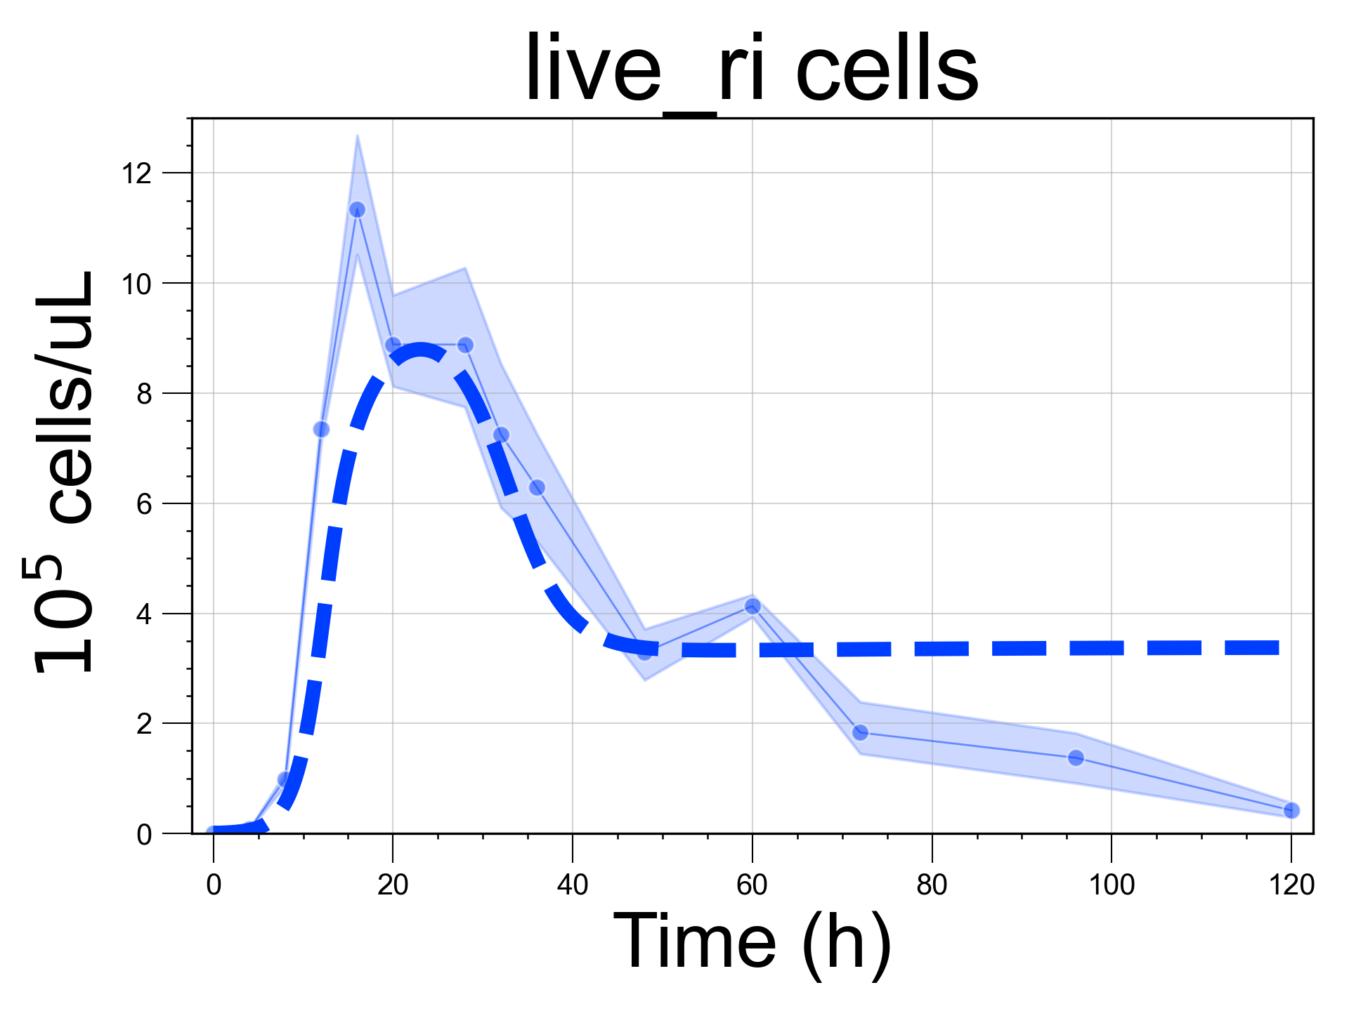
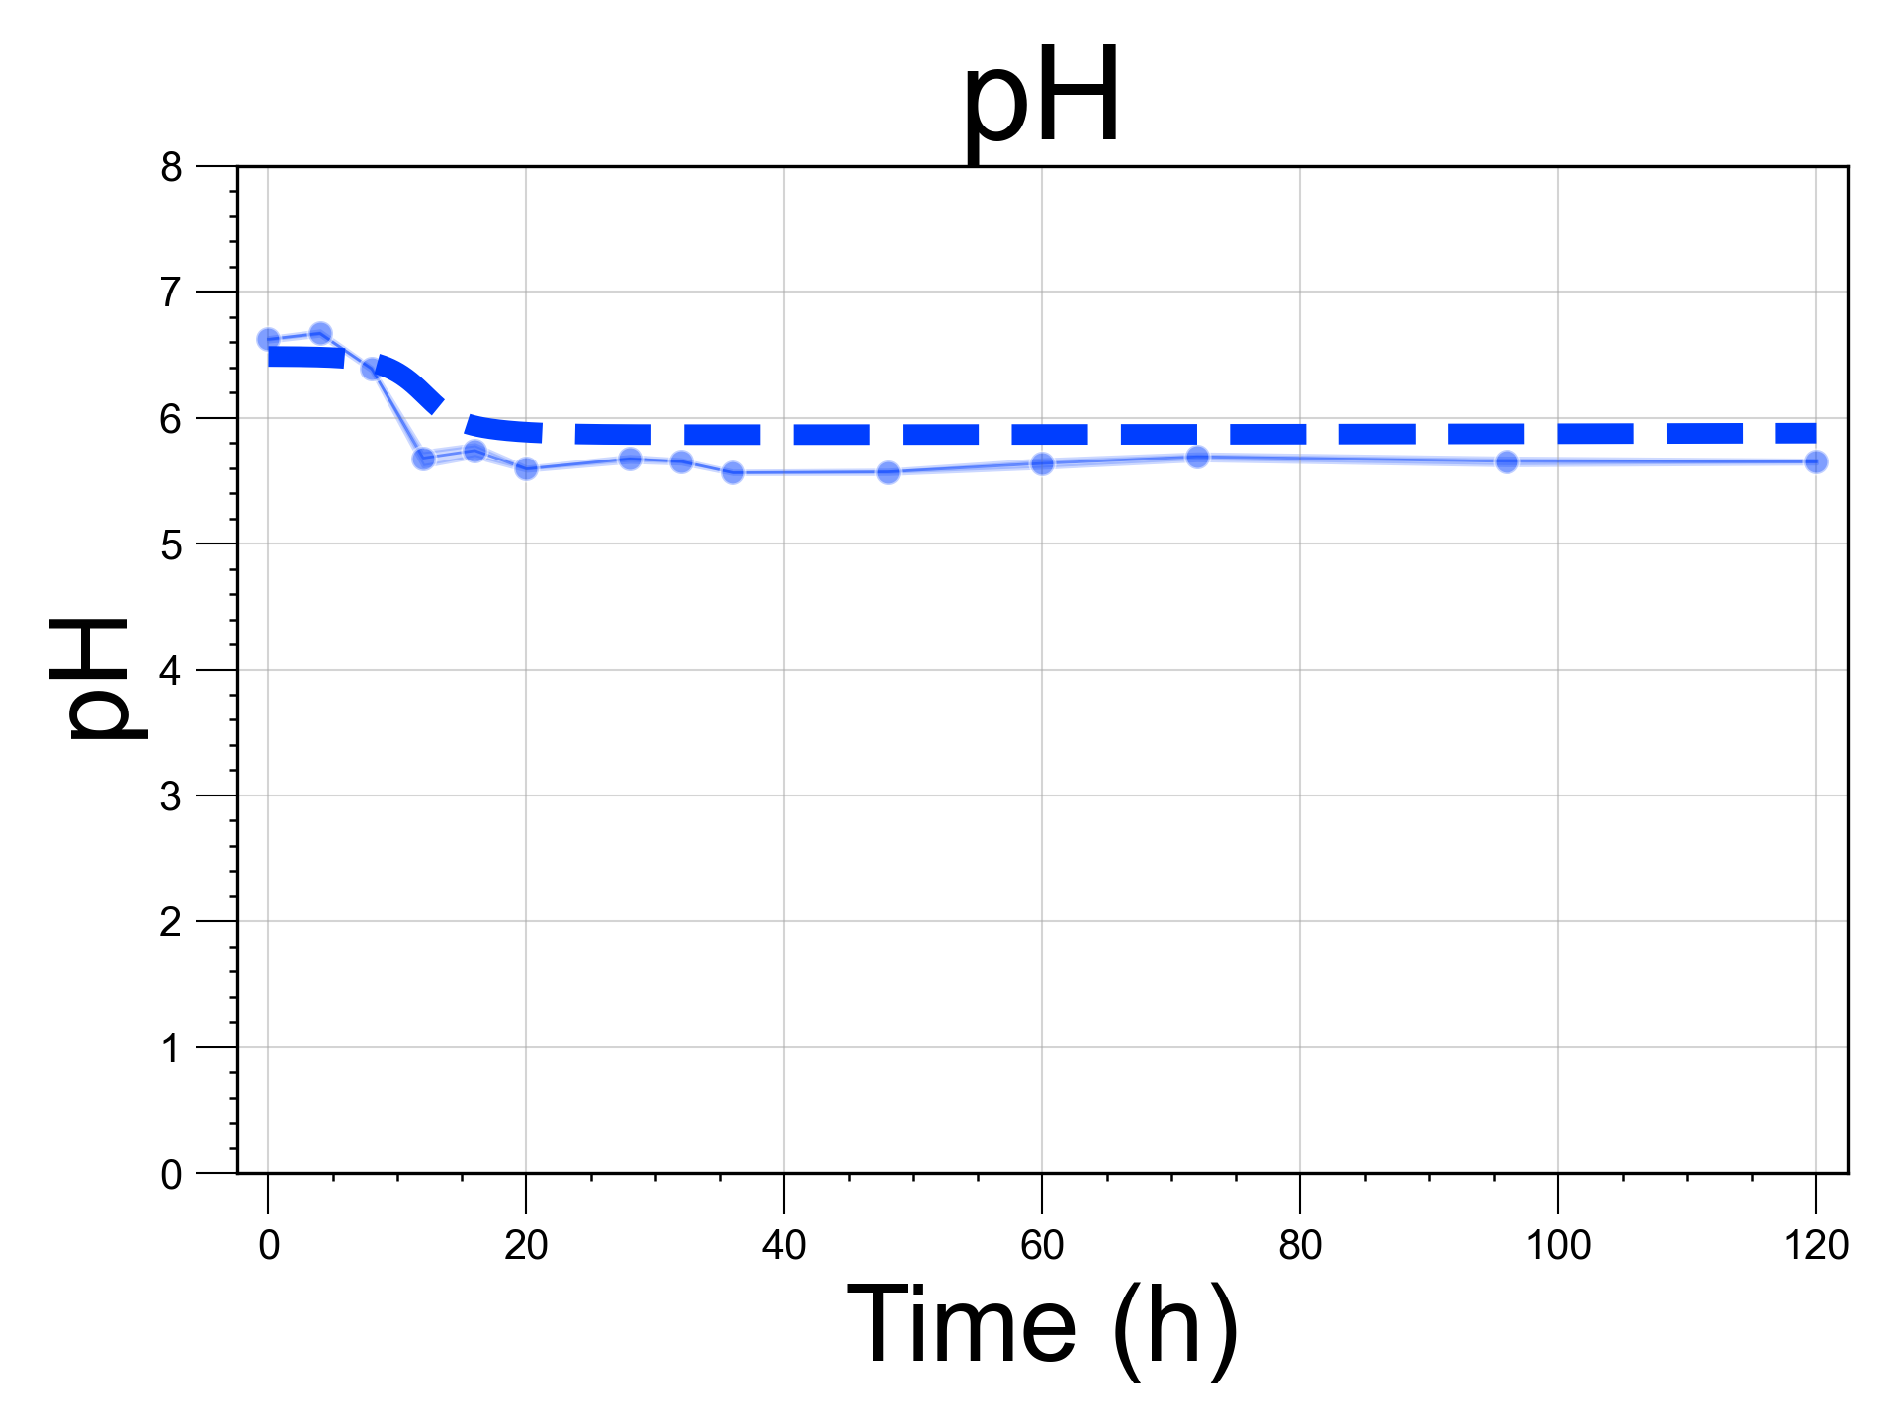
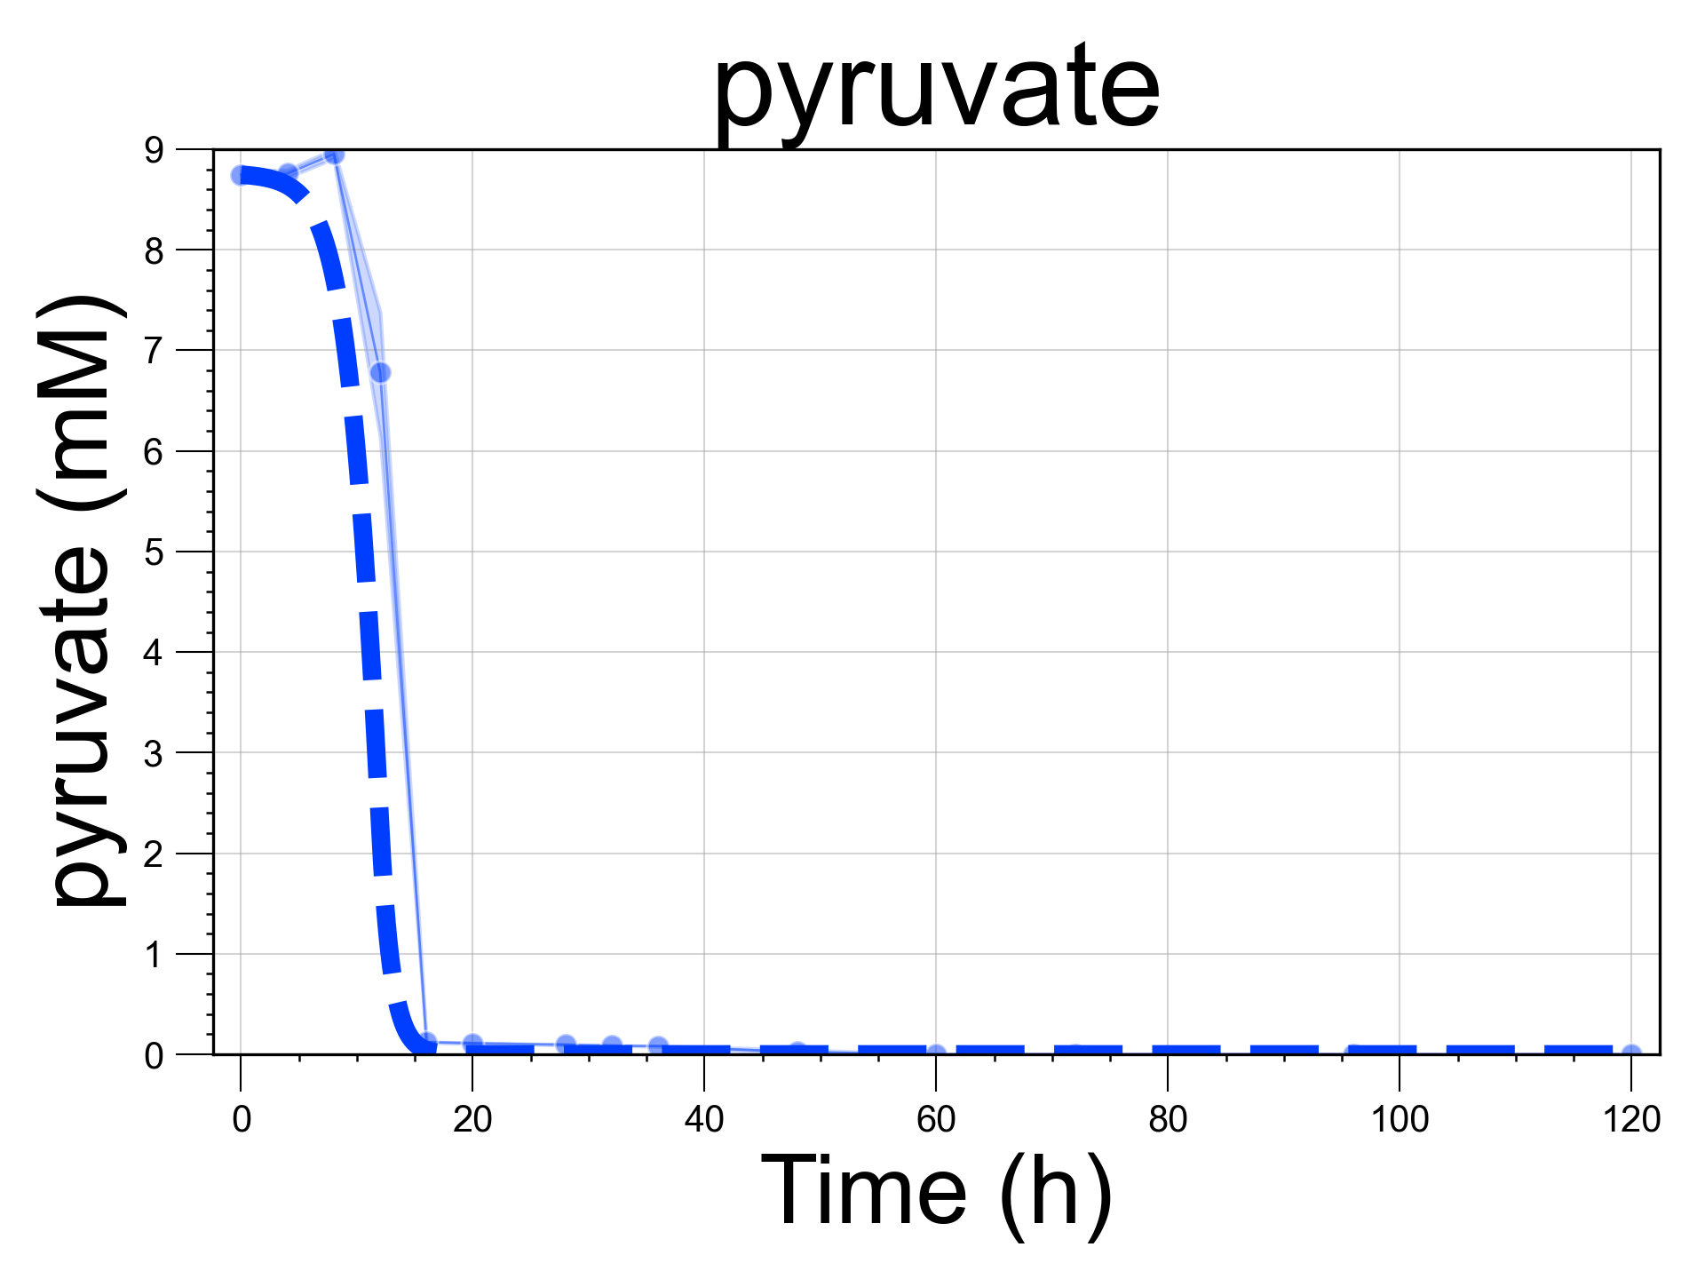
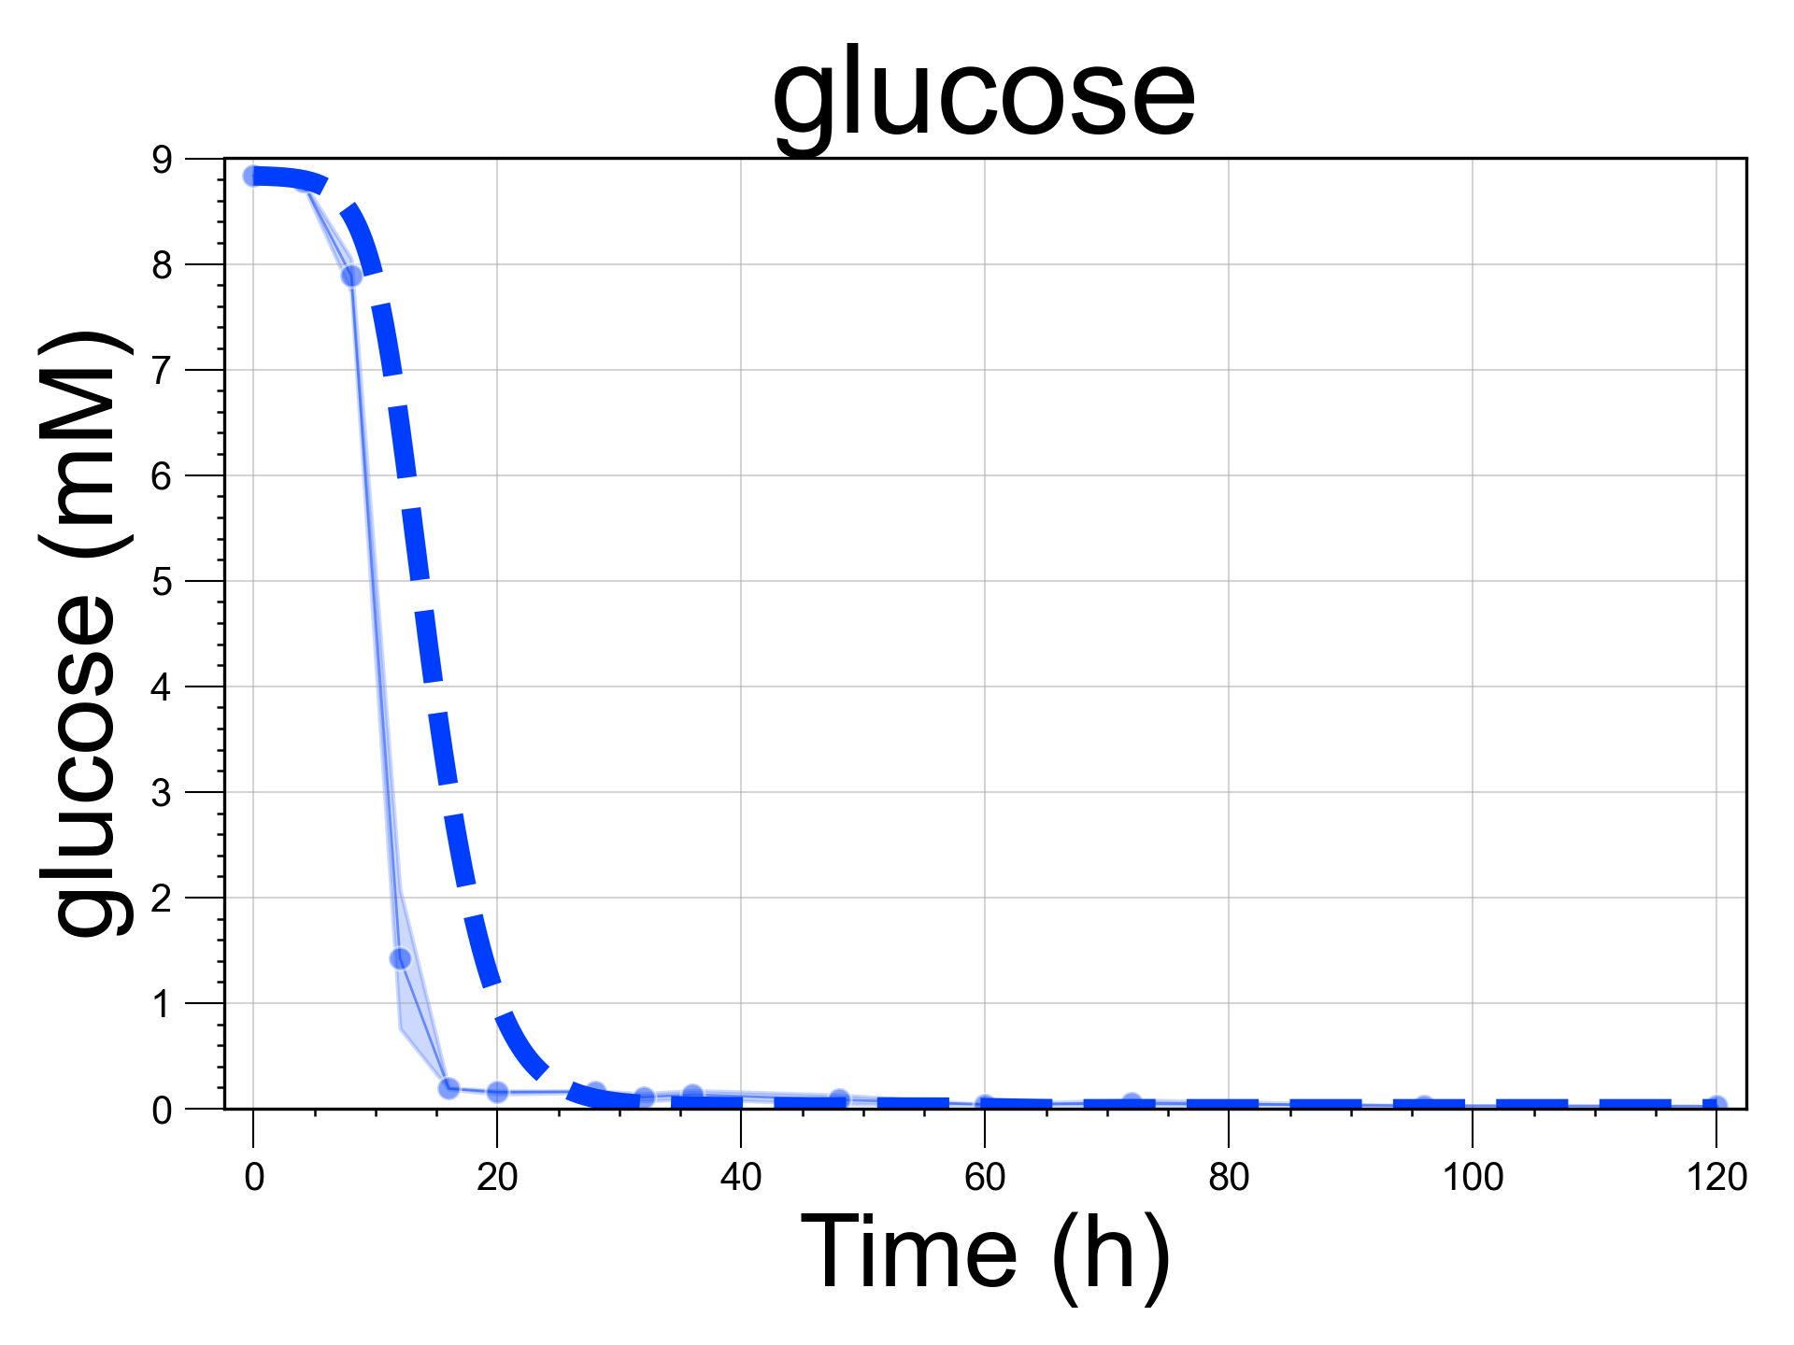
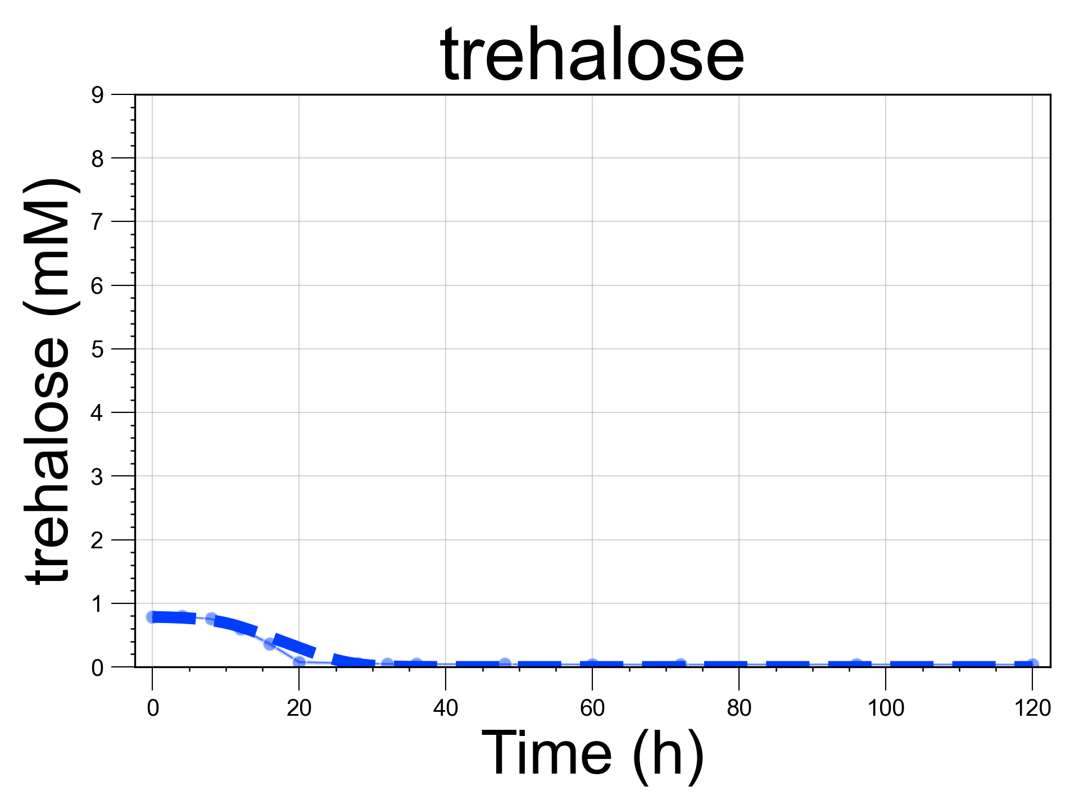
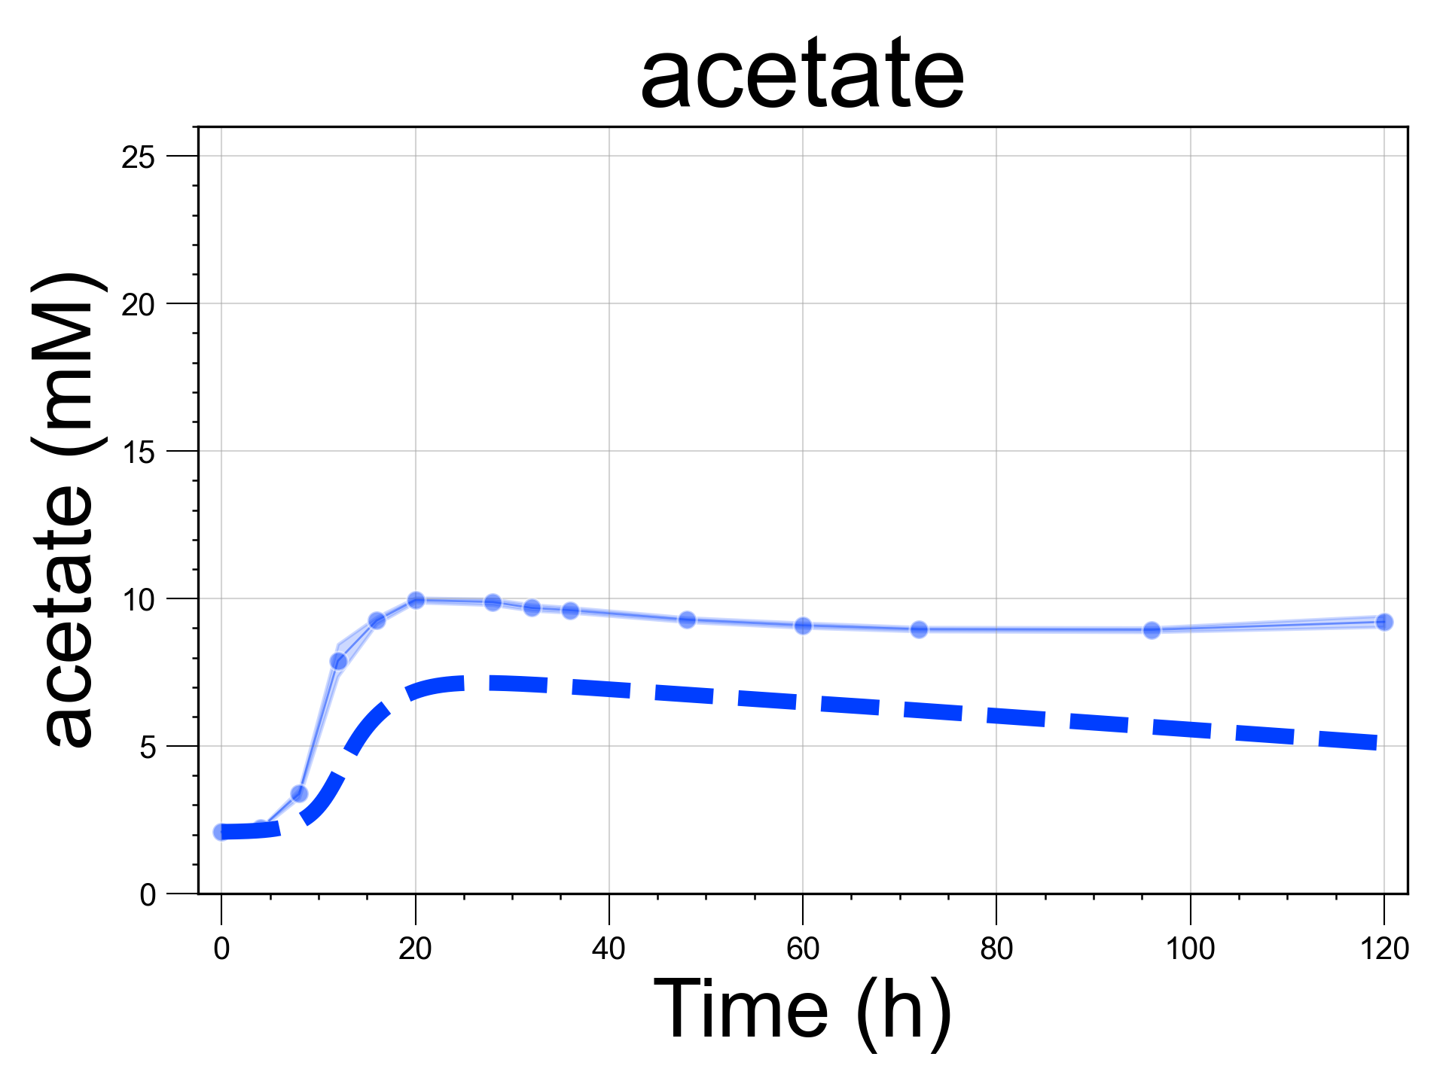
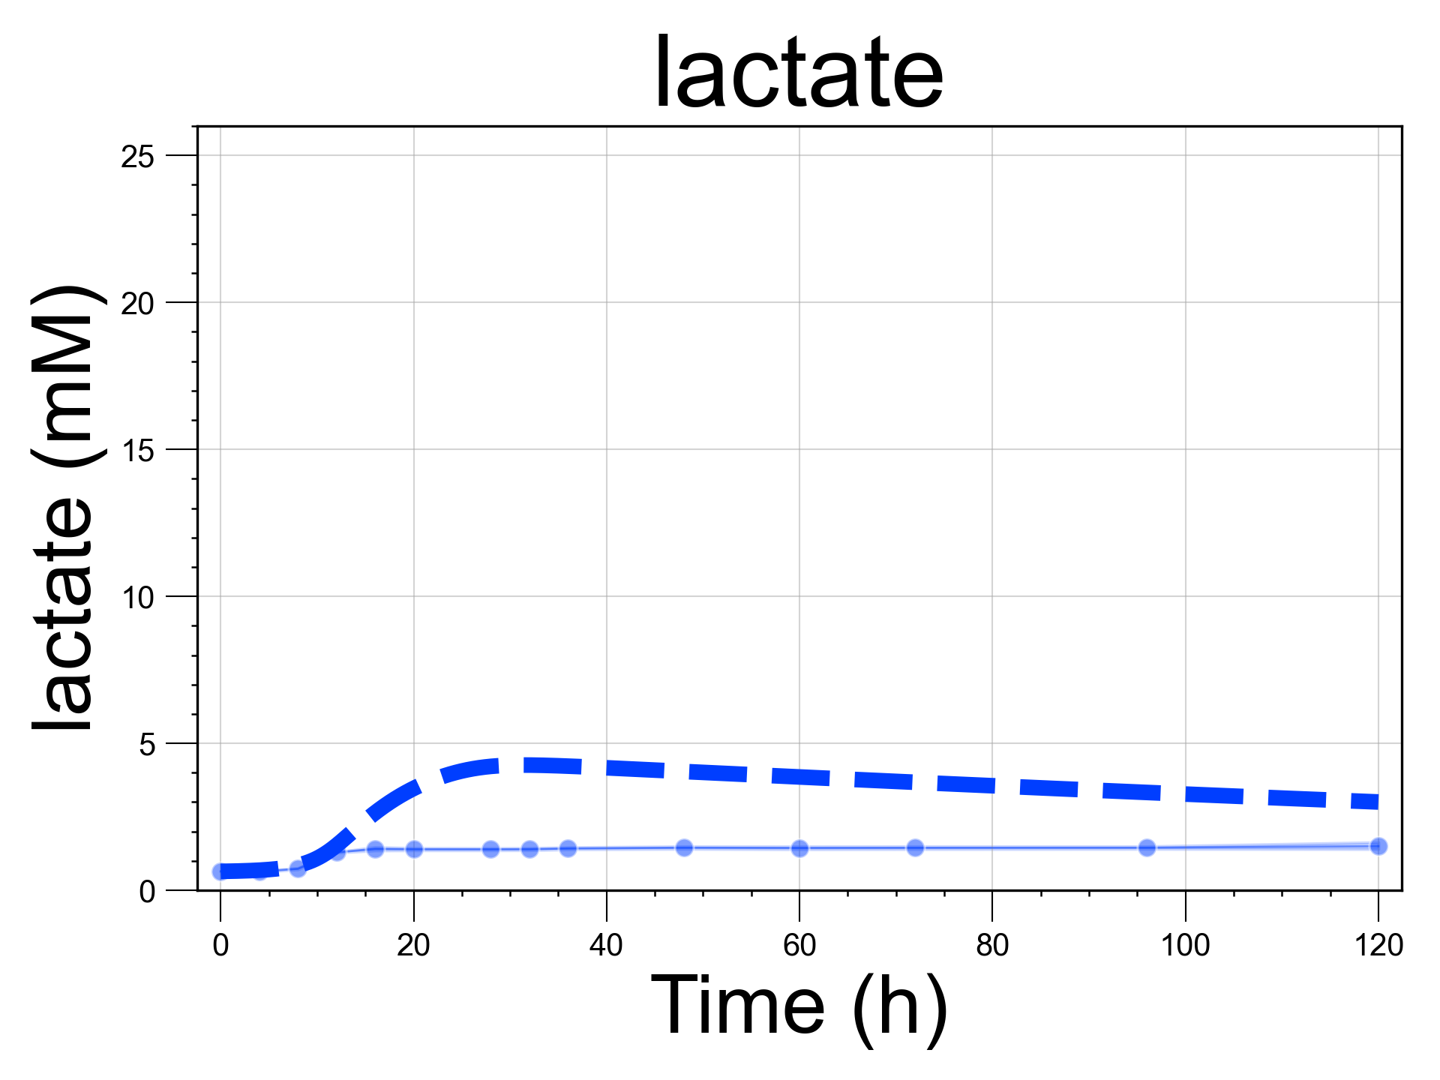
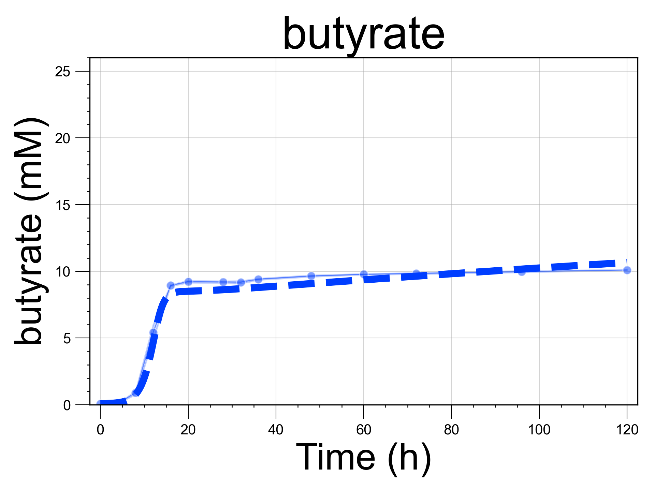
A. Blautia hydrogenotrophica & Bacteroides thetaiotaomicron co-culture
B. Blautia hydrogenotrophica & Roseburia intestinalis co-culture

Slide 13










C. Bacteroides thetaiotaomicron & Roseburia intestinalis co-culture

Slide 14












D. Blautia hydrogenotrophica, Bacteroides thetaiotaomicron & Roseburia intestinalis co-culture
Supplementary Figure S2: Growth kinetics and model validation for three human gut bacteria in co-culture. This figure presents experimental growth data over time alongside model simulations (indicated by dashed lines) for pairs of species and all three species co-cultured in WC medium. The growth data represent averages from six biological replicates. Simulation initial conditions matched those of the experimental setups. In experiment (A), the HPLC analysis for formate failed, resulting in the absence of experimental data points. Only the metabolites that showed changes relative to the blank control are depicted. Other metabolites, such as propionate in all experiments, and trehalose in the co-culture of Bacteroides thetaiotaomicron and Roseburia intestinalis, were measured but remained at levels equivalent to the blank, which consisted of pure WC medium; hence, they are not included in these plots.

Slide 15


Slide 16
Supplementary Figure S3: Two examples of history dependence in simulations using our mechanistic model. In (A), simulations began with dilution rates corresponding to the values on the x-axis and reached a steady state depicted in the top heatmap. After reaching this steady state, the dilution rate was set to zero for 24 hours and then restored to its previous value, allowing the system to achieve a second steady state after 600 hours. This second steady-state is shown in the lower heatmap. Within a certain range of dilution rate values (indicated by the area enclosed in the white traced lines), the system settles into a different steady state than in the case were no perturbation was introduced (notice, the higher concentration of Blautia hydrogenotrophica and acetate and lower concentration of Roseburia intestinalis and butyrate). The two steady states have the same parameter values and emerge depending on the history of the system. This alternative steady state is maintained by feedback loops among phenotypically distinct subpopulations. For instance, if the initial population of Blautia hydrogenotrophica's glucose-consuming cells exceeds a tipping point, an increase in the steady-state concentration of trehalose (achieved by increasing the dilution rate) prompts B. hydrogenotrophica cells to switch to consuming the excess trehalose, keeping trehalose levels low and allowing glucose-consuming cells to persist. In other words, whether glucose-consuming cells persist or not depends on their initial population, which in turn depends on the history of the system. Using principal component analysis (PCA), the model state can be summarized by a single state value (its first principal component). In the lower plot, one clearly sees the coexistence of two states under the same parameter regime within the traced line (top unperturbed and bottom perturbed states).
(B) A similar example of history dependency can be seen by controlling the system’s pH at specific values (for instance, by adding a buffer). In these simulations, in the top heatmap we show the steady state reached by the system when the pH is fixed from the beginning at the values in the x-axis. While in the lower one, we instead initialize the system with a fixed pH of 5.6 for 60h. A short time period that would not lead Roseburia intestinalis to extinction and not necessarily enough time to reach a steady state. After 60h, we set the pH to the specific value in the x-axis and allow the system to reach steady state (for 600 h). Here, once more within the range indicated by the white traced lines, two alternative states were reached that depend on the system’s history. In other words, the concentration of subpopulations that emerge after the initial incubation at pH 5.6 is more robust to pH changes and stabilizes the system in a different state compared to the initial populations of a standard incubation.

Slide 17

Supplementary Movie S1: flow cytometry time series of Blautia hydrogenotrophica's growth in WC medium, corresponding to experiment 1 shown in main Figure 1D. ‘t' represents the hours of cultivation. The x-axis displays the intensity of the SYBR green staining, indicative of viable (non-permeable) cells, while the y-axis shows the intensity of propidium iodide staining, which marks non-viable (permeable) cells. Between 24 and 32 hours, two distinct subpopulations of similar sizes become apparent. These subpopulations were not observed in the experiments where WC medium was supplemented with trehalose (see Supplementary Figure S1).

Slide 18

Supplementary Movie S2: trajectories of two experiments in principal component analysis space. The measured state-space consisting of eight metabolite concentration (in mM) and three species abundance (in 10⁵ cells uL⁻¹) measured in 762 samples were scaled to zero mean and unit variance and used to generate a background PCA (green dots). The temporal dynamics of the experiments and their conditions are highlighted for experiment one (A) and two (B). Notice that the points corresponding to twelve control vessels in experiment two were not subject to the perturbation, but were used as a control during the full time of the experiment and are not highlighted during the perturbation, but remain in the same ellipse as the other perturbed vessels before the perturbation was applied. The points used to draw the ellipses are detailed in the second tab of the Supplementary Table S2

Slide 19
Supplementary Tables
Supplementary Table S1: comparative glucose and trehalose specific IIA component (EC 2.7.1.201 and EC 2.7.3.9) in Blautia genomes in the BV-BRC database. The nine Blautia hydrogenotrophica genomes highlighted in red harbor the “PTS system, trehalose-specific IIB component (EC 2.7.1.201)”, but do not harbor the “PTS system, glucose-specific IIA component (EC 2.7.1.199)” (second tab)
Supplementary Table S2: Metabolites and cell counts measures in minibioreactors. This data was used to generate the PCA plots and heatmap of Figure 3C and Supplementary Movie S2.

